Slide 1
Unit 8 Wonderland
Pronunciation
(Sense groups)

Slide 2
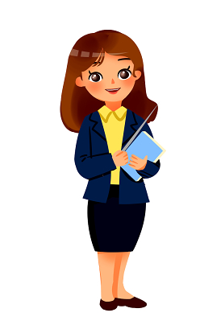
Activity 1: Warm up
Boys and girls, before we learn something new, let’ s say a tongue twister together. Ready? Go!
Can you can a can as a canner cans a can?
(你能像一个罐头工人一样装罐头吗？)
/
When we say a tongue twister, how can we be fast?
Do we need to stop in the sentence?
Where can we stop?

Slide 3
Activity 2: Read and find
1. Read sentences to find where to stop.
1) I like reading after I finish my homework.
2) After school, my friends and I went to different clubs.
3) The most important thing in life is to be happy and kind to others.
/
/
/
/
/
/

Slide 4
Activity 2: Read and find
2. Try more and pay attention to the differences.
(1) I saw a man / with binoculars.
I saw / a man with a binoculars.
(2) They fed her/ dog food.
They fed her dog / food.
(3) I / visited the men who lived next door / yesterday.
I visited the men / who lived next door yesterday.
sense groups(意群)

Slide 5
Activity 3: Think and work out the rule
What is a sense group (意群)?
A sentence is made up of several parts according to meaning or grammar structure. Each part is one sense group.
A word, a phrase, a clause can be a sense group. Between sense groups, there should be a short pause.
How can we divide(划分) sense groups?

Slide 6
Types | Structures | Examples
Noun phrase | Article + adjective + noun | a beautiful woman
Verb phrase | Verb + adverb | run quickly
 | Verb + object | climb tall trees
 | Auxiliary verb + main verb | will dance
Prepositional phrase | Preposition + noun phrase | with my friends
 |  | in the future
Clause | Object clauses Adverbial clauses, ect. | I wonder how he got the idea.
 |  | He can’t come here because he is ill.

Slide 7
Activity 4: Practise
Read the sentences below and mark pauses (/) where you think they are necessary.
1 Journey to the West is one of my favourites.
2 I like the Monkey King best. He is very clever.
3 This book makes me want to try new things.
4 I also want to travel and have exciting experiences in the future.
5 I enjoy reading fantasy books because I find them really exciting.

Slide 8
Activity 4: Practise
Read the sentences below and mark pauses (/) where you think they are necessary.
Listen and check your answers.
1 Journey to the West is one of my favourites.
2 I like the Monkey King best. He is very clever.
3 This book makes me want to try new things.
4 I also want to travel and have exciting experiences in the future.
5 I enjoy reading fantasy books because I find them really exciting.

Slide 9
Activity 4: Practise
Read the following text aloud. Add pauses (/) in the right places. Listen and check.
I tried an audiobook last weekend. I played the book on my phone. I listened for over two hours and did not want to stop. I enjoyed it because the story is really exciting. Also, I could do other things at the same time. I tidied my bedroom while I listened.

Slide 10
Activity 4: Practise
Read the following text aloud. Add pauses (/) in the right places. Listen and check.
I tried an audiobook last weekend.
I played the book on my phone.
I listened for over two hours and did not want to stop.
I enjoyed it because the story is really exciting.
Also, I could do other things at the same time.
I tidied my bedroom while I listened.

Slide 11
Activity 5: Further practise
Down the rabbit hole
One sunny day, Alice and her sister sat by a river. Then Alice heard a sound. She looked up and saw a white rabbit in a coat passing by.
“Oh dear! I’ll be late!” said the rabbit. It took a watch out of its pocket and looked at the time.
How amazing! Alice stood up and ran across the field after the rabbit. The rabbit jumped down a big hole. Alice did not want to let the rabbit get away, so she jumped down the hole too.
Down, down, down. Alice fell for a long time, and then she hit the ground. She found herself alone in a long, low hall. There were doors all around, but they were all locked. Alice saw a small key on a table, but it did not fit any of the locks.
Then Alice noticed a small door and put the key into the lock. The door opened! She could see a lovely garden on the other side. Alice tried to go through the door, but she was too big.

Slide 12
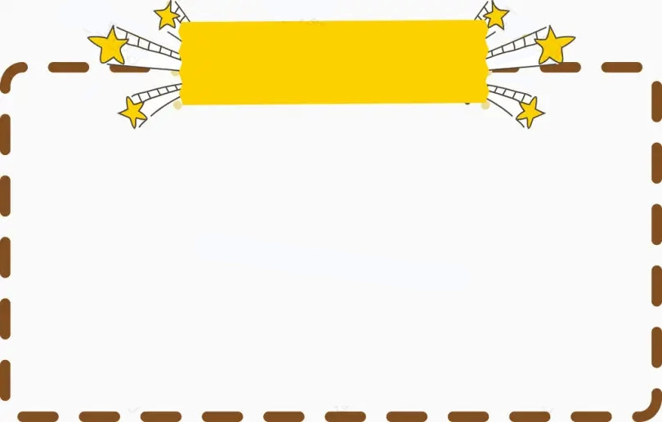
Homework
Must do:
Try to read the story on Page 102 with right pauses.
2. Preview Integration.
Choose your favourite passage, read and make a video to share with us.
Choose to do:

Slide 13
Thank you!

