Slide 1
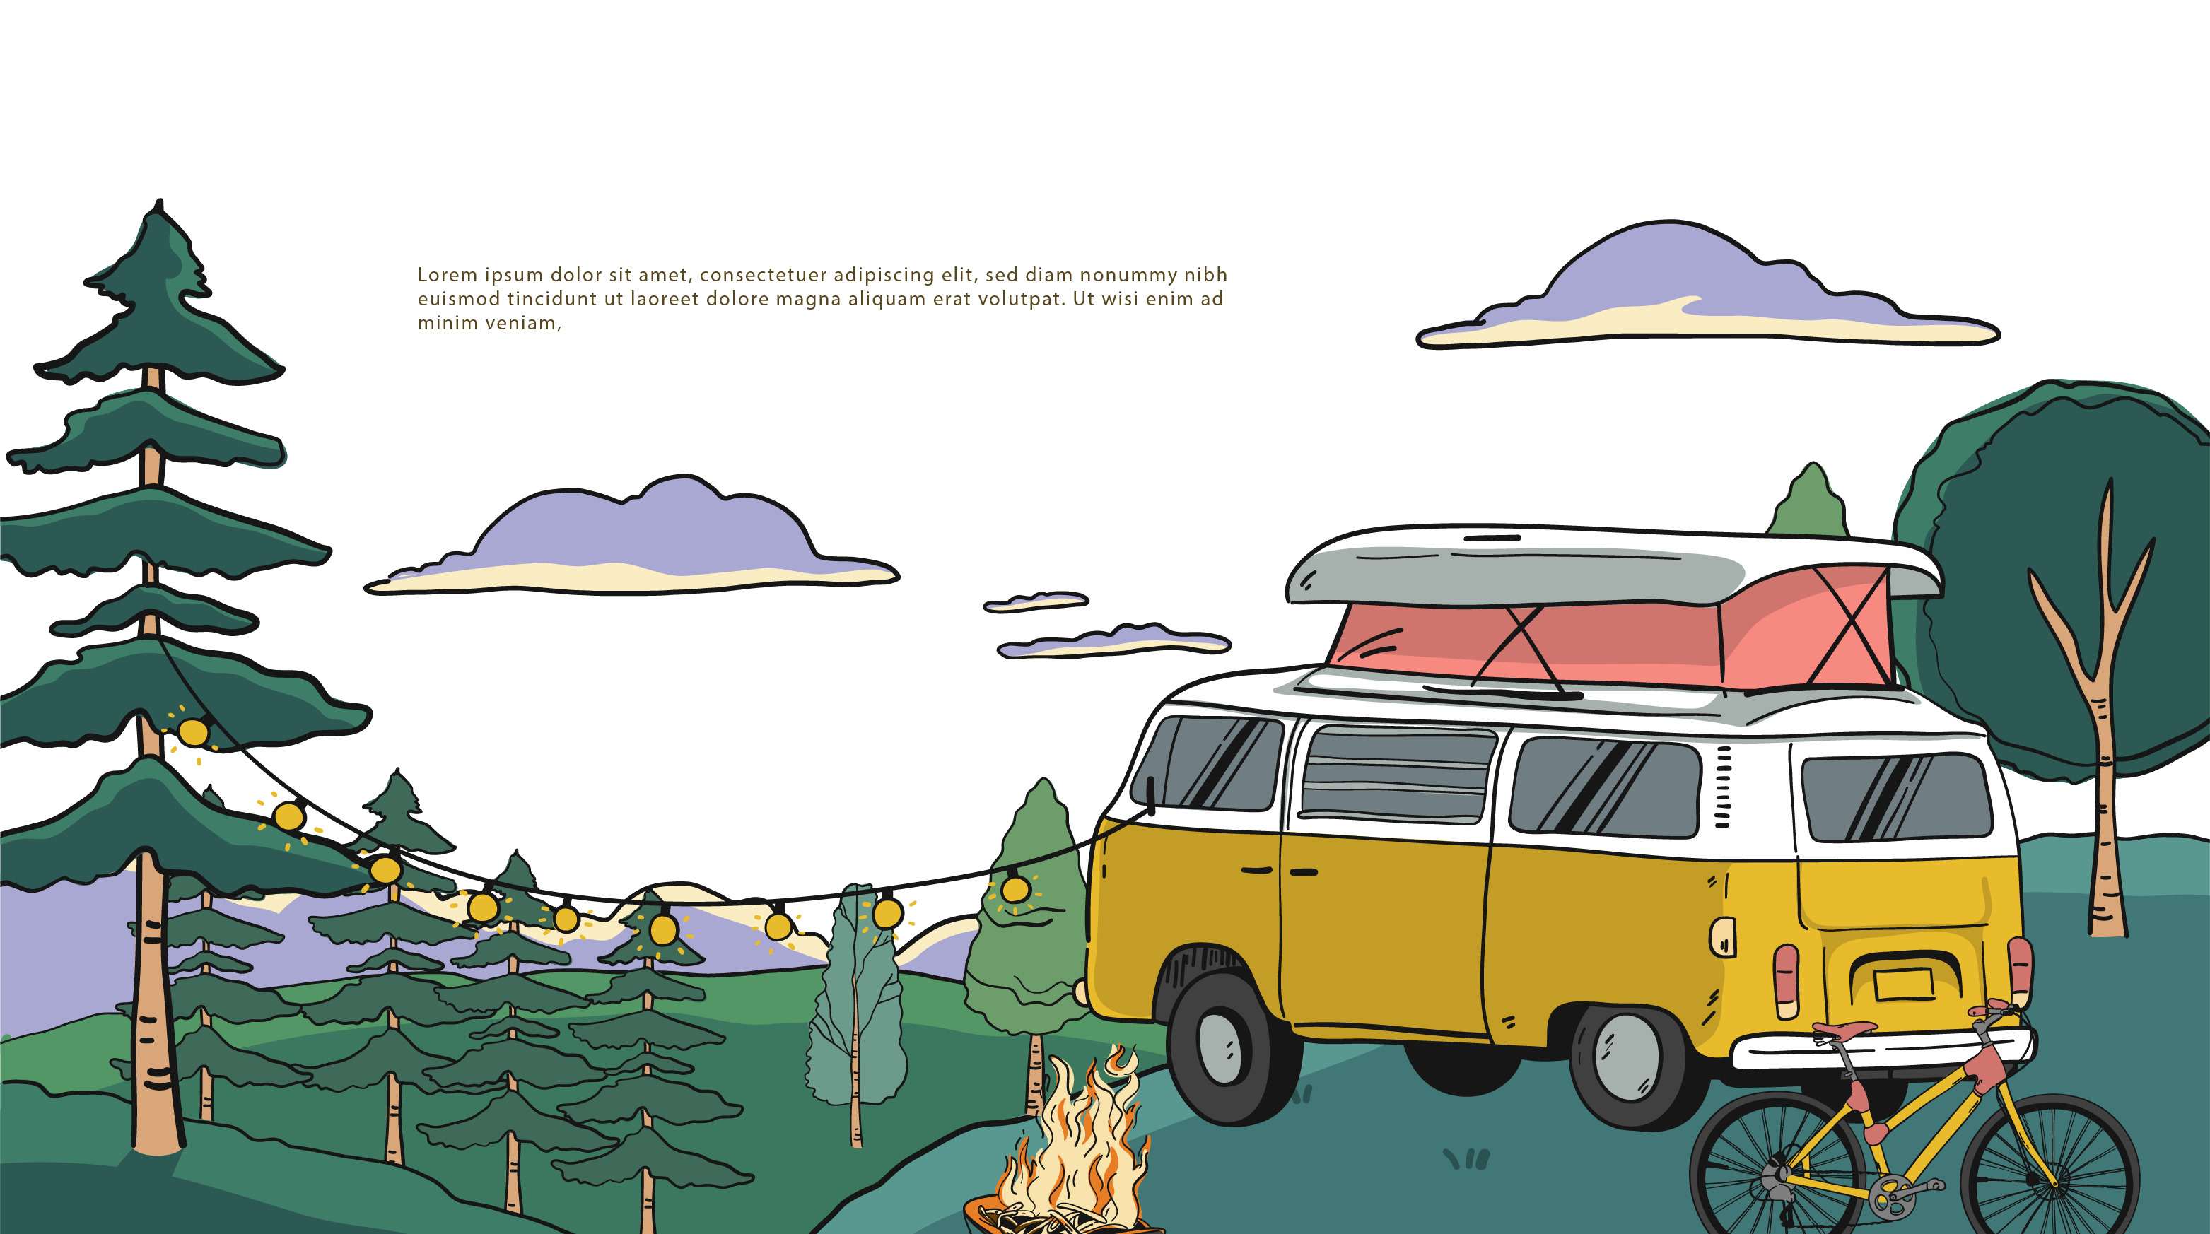
译林牛津2025年春
7B Unit7 Outdoor Fun
Reading 2

Slide 2
Revision
Introduce Simon’s cycling trip according to the following chart
Basic information
(who,when,where, what, how
Simon …a cycling trip with ….It …a/an …experience.
After breakfast, they …a little village. Their phone…so they….But luckily, a driver stopped and …
An hour later, they…and they were…. The village…. After lunch, they walked around and …. Simon used…..They …some photos. It was…
On their way back, Sandy’s bike…. Daniel…We all….We were…but…
Simon’s
cycling trip
The process
(activities, problems,solutions)
Conclusion
(feelings, what you learn from it)
It was …！We had …and …. I can’t….

Slide 3
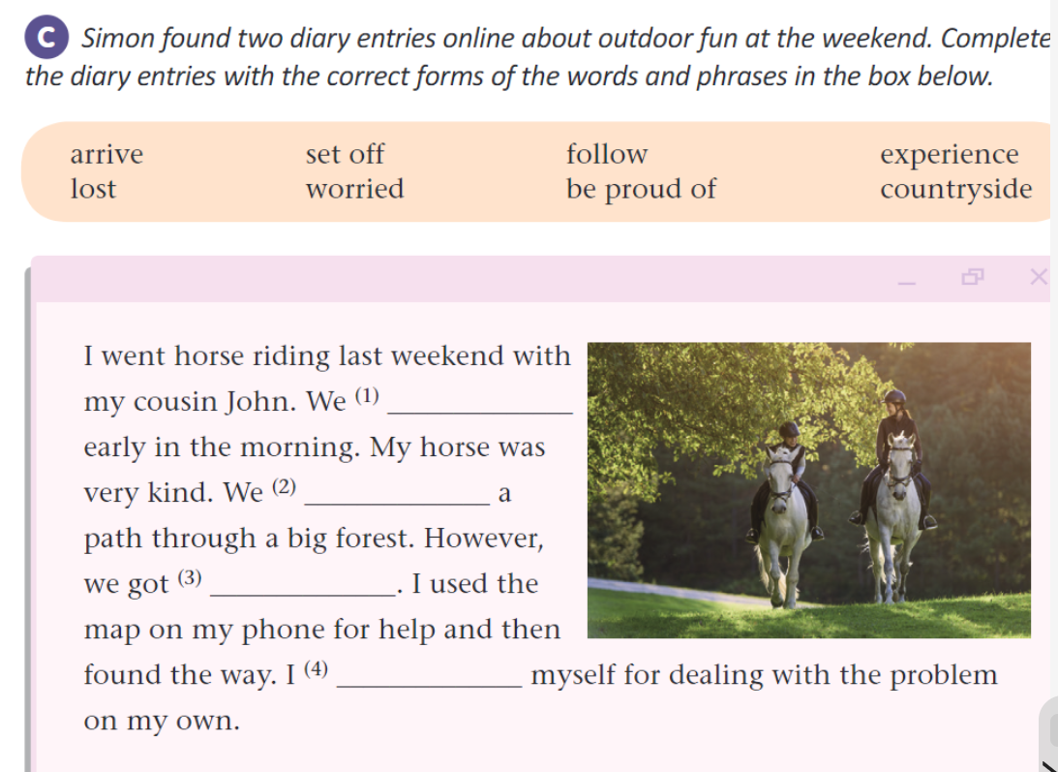
Exercise
set off
followed
lost
was proud of

Slide 4
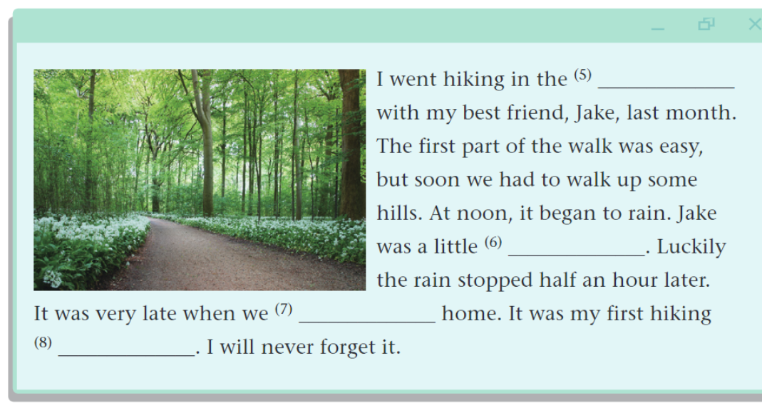
Exercise
countryside
worried
arrived
experience

Slide 6
Language points
It was an amazing experience!
C.n. 经历
an unforgettable experience 一次难忘的经历
U.n. 经验
have experience in doing sth 做某事有经验
a teacher with ten years’ experience 一位有着十年经验的老师
V. 体验
experience the charm of Chinese culture 体验中国文化的魅力
adj. experienced 有经验的
an experienced teacher 一位有经验的老师
experienced
experience
The____________teacher has much ____________in teaching students.(experience)

Slide 7
Language points
After breakfast, we set off for a little village.
set off 出发，动身，启程
燃放 set off fireworks 燃放烟花
set up 建立 set up a company 建立一个公司
set out 出发，动身；开始
set aside 留出（时间或金钱）； 不顾，不理会
a set of 一套，一组
I am going to _________America with my friends .
A. set up B. set off C. set off for D. set out
My father _________a charity organization last year.
A. set up B. set off C. set out D. set aside

Slide 8
Language points
We followed the map on my phone, but it didn’t give enough details about the countryside.
follow v. 遵循 follow the rules 遵守规则
v. 跟随 follow in the footsteps of sb 跟随某人的脚步
follow the heart 跟随内心
v.跟踪
following adj. 接下来的，之后的
When we drive, we need to __________the traffic rules.(follow）
We are looking forward to the ____________holiday.(follow）
follow
following

Slide 9
Language points
We followed the map on my phone, but it didn’t give enough details about the countryside.
detail n. 细节；具体情况 in detail 详细地
detailed adj.详细的
Can you explain the case in __________.(detail)
The ___________information can be found on our website.(detail)
The ________of the discussion were not given.(detail)
detail
detailed
details

Slide 10
Language points
We got lost.
lost adj.迷路的 get lost 迷路
adj.丢失的 the lost key 丢失的钥匙
*lost和missing的区别：
lost指永久性消失，无找回可能，missing是暂时消失，可能找回
lost是动词lose的过去式和过去分词
lose v. 丢失，失去；输掉 lose one’s way=get lost 迷路
lose weight 减肥 lose ccontrol 失控
lose heart 失去信心 lose face 丢脸
loser n.失败者
Unluckily, they_________the football game again.(lose).
When we arrive in a new city, it’s easy to _______our way.(lose）
The police are trying their best to look for the________boy.(lost,missing）
lost
lose
missing

Slide 11
Language points
None of us knew the right way
none pron.没有一个
none表示三者或三者以上的人或物一个也没有
none可以指代可数名词，也可以指代不可数名词，做主语时，若指代不可数名词，谓语动词用单数，若指代可数，谓语动词可单可复
none可以和of连用，后面加复数名词
--How many birds are there in the tree? --_________.
A. No one B. Nothing C. None D. No
None of the money on the table ______(be)_________(I).
is
mine

Slide 12
Language points
I was a little worried.
worried adj. 担心的，发愁的 be worried about sb/sth 担忧某人/某事
worrying adj. 令人担忧的
worry U.n 担忧 c.n. 令人担忧的事情 （p.l.worries）
worry vt.使…担忧
Tom always worries his parents.汤姆总是让他的父母担忧
worry vi. 担忧 worry about sth/sb 担忧某事/某人
Tom always worries about his old parents.汤姆总是担忧他年迈的父母
worried
worrying
worried
The________mother looked at her________son,looking _______.(worry)
Can you tell me what you are _________________(worry)about?
Everything is ready. You have nothing to __________.
A. worry B. worried C. worry about D. be worried
worrying/worried

Slide 13
Language points
but luckily, a driver stopped and told us which way to go.
luckily adv. 幸运地 反：unluckily 不幸地
lucky adj. 幸运的 You‘re lucky to live in such a nice neighbourhood.
unlucky adj.不幸的
luck u.n 运气 Wish you good luck
unlucky
Millie is __________to fail the exam again.(luck)
__________, Lucy found her lost key.(luck)
--We are going to have a basketball game with Class 2.
--________.
A. Have a good time B. Good luck C. I’m sorry to hear that D. Thanks
Luckily

Slide 14
Language points
We cycled for another hour and then arrived at the village
arrive vi. 到达 arrive in+大地点 arrive at+小地点
arrive in/at=get to=reach 到达
He is the first one to _________school.
A. arrive B. arrive at C. get D. arrive in
Last night, they ________home at ten o’clock.
A. arrived B. arrived at C. got to D. arrived in
I’ll ring you up as soon as I _______.
A. arrive B. arrive at C. get to D. reach
The train ____________(arrive) in five minutes.
is arriving

Slide 15
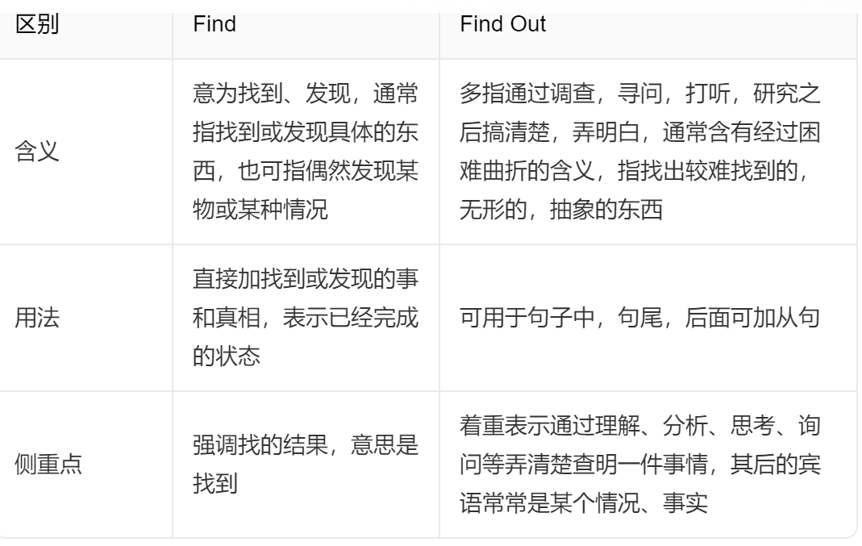
Language points
I used an app to find out more about them.
Please help me _________who broke the window just now.
A. find B. find out C. look for D. discover

Slide 16
Language points
but we were proud of our teamwork
proud adj. 骄傲的，自豪的 be proud of 为…感到骄傲，自豪
pride n.骄傲，自豪 take pride in 为…感到骄傲，自豪
proudly adv. 骄傲地，自豪地
China has made great achievements. We _________our amazing country.
A. are proud B. are proud of C. take pride D. be proud of
His __________stopped him from asking for help.(proud)
“We come first in the football game.”The teacher said___________(proud).
pride
proudly

Slide 17
Language points
I can’t wait to do it again.
can’t wait to do 迫不及待去做某事
区分： can’t help/stop doing 情不自禁做某事，忍不住做某事
to share
Daniel could wait___________(share) the good news with his parents.
She can’t help _________(smile) when seeing her child.
smiling

Slide 19
yi
一. 根据提示写出适当的单词
1. They are ______ (骄傲的) of their teamwork.
2. Half an hour ______ (late), we __________(到达) at the village.
3. ___________ (follow) a path through the forest is interesting.
4.Sleeping under the stars is a special ____________(经历).
5. The students got _______(迷路的). They looked very _________(担忧的)
6. The police are trying to_____________(查明）the truth.
7. Sandy likes to go_________(cycle) when she is free.
8. I will never forget the ___________(令人愉快的）trip！
proud
later
arrived
Following
experience
lost
worried
find out
cycling
enjoyable

Slide 20
yi
Homework
1. Remember the language points.
2. Finish the corresponding exercises
3. Introduce Simon’s cycling trip according to your poster to your parents or friends.

Slide 21
译林牛津2025年春
Thanks for watching

