Slide 1
七年级下册
Unit 5 Animal Friends
Grammar

Slide 2
Learning objectives
By the end of the lesson, I will be able to...
1. learn some core words and expressions of the text;
2. use adjectives and can, could and may correctly.

Slide 3
形容词
形容词

Slide 4
What is an adjective?
1 He does wonderful tricks,
Builds me camps out of sticks.
2 My goldfish is a wonderful pet.
3 Rabbits have long ears.
4 A lazy cat is sleeping on the sofa.

Slide 5
Why do we use adjectives?
形容词：
用来表示人或事物的性质、状态及特征。
“... ...的”
1 He does wonderful tricks,
Builds me camps out of sticks.
2 My goldfish is a wonderful pet.
3 Rabbits have long ears.
4 A lazy cat is sleeping on the sofa.

Slide 6
How do we use adjectives?
1 He does wonderful tricks,
Builds me camps out of sticks.
2 My goldfish is a wonderful pet.
形容词可以放在名词前充当定语。
3 Rabbits have long ears.
4 A lazy cat is sleeping on the sofa.

Slide 7
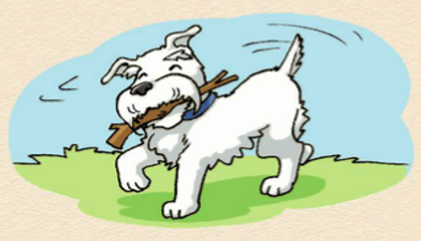
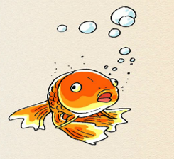
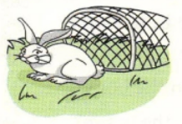
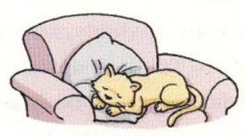
Complete the sentences with correct forms of be.
1 He does wonderful tricks.
His tricks ___ wonderful.
are
2 My goldfish is a wonderful pet.
The pet ___ wonderful.
形容词也可放在
系动词后充当表语。
is
3 Rabbits have long ears.
Rabbits' ears ___ long.
are
4 A lazy cat is sleeping on the sofa.
The cat on the sofa ___ lazy.
is

Slide 8
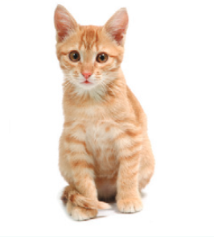
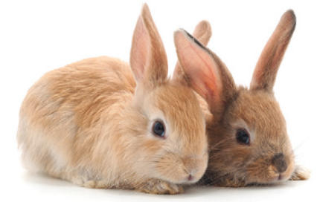
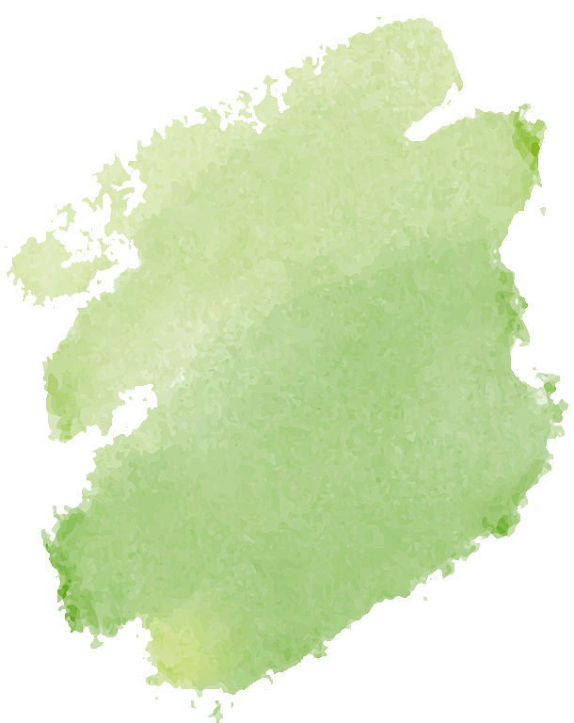
How do we use adjectives?
形容词用法
Rabbits have long ears. Rabbits’ ears are long.
The orange cat looks cute. The cute cat is orange.
We use adjectives to describe people or things.
• We can put an adjective _________ (before, after) a noun.
• We can put an adjective _________ (before, after) a linking verb.
Work out
the rule
before
系动词
after

Slide 9
What is a linking verb系动词?
表状态的be动词
am, is, are
感官动词
feel, look, smell, taste, sound
系动词
表变化的动词
go (变；成为), become (成为，变得), get (变得), grow (渐渐变得), turn (变成)等

Slide 10
Can you find out the linking verbs?
1. I love all seasons. I never feel hot or cold.
2. In spring, the weather starts to get warm.
3. Everything turns green.
4. The weather is hot in summer.
5. Leaves turn brown, red or yellow and start falling from the trees.
6. Winter is often cold and snowy.

Slide 11
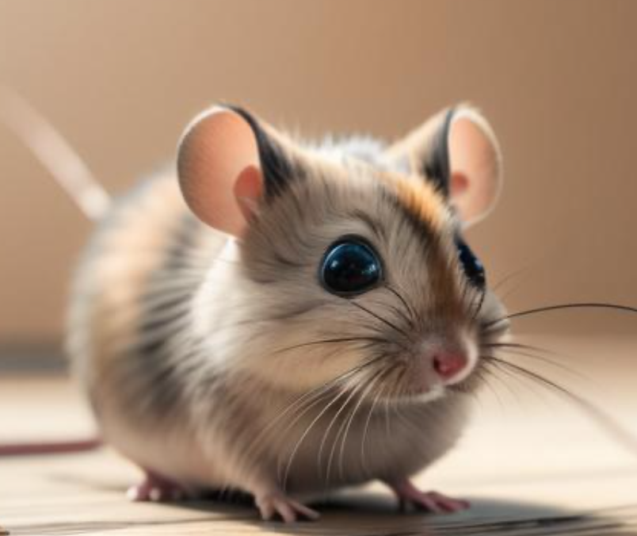
brown clever happy hungry special tired
I have a (1) ______________ mouse.
She likes to play with me. When
she gets (2) ______________, she
sleeps in the corner of her cage.
She makes a soft sound when she
is (3) ______________.
brown
tired
/ˈkɔːnə(r)/ n. 角落；街角
hungry

Slide 12
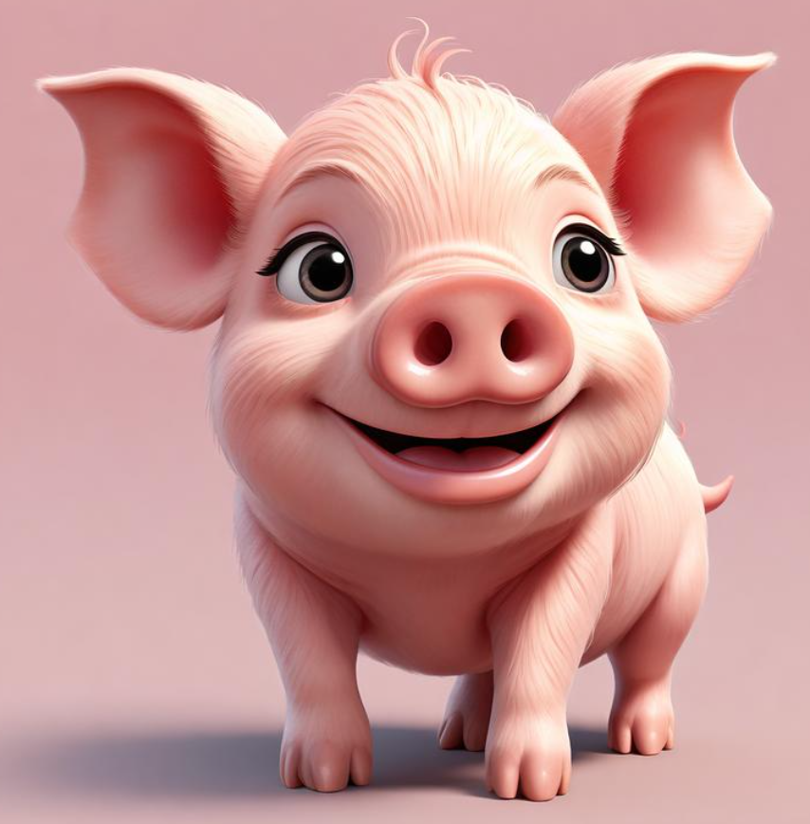
brown clever happy hungry special tired
My grandma has a pet pig. He is a
(4) ______________ friend of mine.
He is very (5) ______________ and
knows his name. He runs over
to see me when I call him. He is
(6) ______________ all the time.
special
clever
happy

Slide 13
Here are some pictures. Make sentences about them, using adjectives.
P61
The bee is busy, and the flowers are beautiful.
The cat is cute.
The boy is curious about the colorful fish.
The old man is walking his lovely dog in the park.

Slide 14
情态动词
can, could 和may的用法

Slide 15
Why do we use can/could/may?
1 —Can your parrot talk?
—No, she cannot talk, but she can do tricks.
2 —Could I play with your dog?
—Yes, you can. He’s very friendly.
3 —May I feed your goldfish?
—Sorry, I’m afraid you can’t.
4 —Can your cat jump high?
—No, she can’t. But when she was young, she
could jump really high.
Can you work out the rule?

Slide 16
1 —Can your parrot talk?
—No, she cannot talk, but she can do tricks.
2 —Could I play with your dog?
—Yes, you can. He’s very friendly.
3 —May I feed your goldfish?
—Sorry, I’m afraid you can’t.
4 —Can your cat jump high?
—No, she can’t. But when she was young, she
could jump really high.
Let’s learn more.
情态动词can, could表示能力：
can表现在的能力，could表过去的能力。
Examples: conversations 1 and ___________
情态动词can, could，may表示许可
Examples: conversations 2 and ___________
4
3

Slide 17
How do we use can/could/may?
can/could 表“能力”
肯定句: 主 + can/could + 动词原形 …
(1) They can play basketball.
(2) She could dance at the age of six.
他们会打篮球。
他六岁就会跳舞。

Slide 18
How do we use can/could/may?
否定句: 主 + can't/couldn't + 动词原形 …
(1) She cannot swim.
(2) We cannot/can't see electricity.
(3) He couldn't answer the question.
她不会游泳。
我们看不见电。
他没有能回答那个问题。

Slide 19
How do we use can/could/may?
疑问句：Can/Could + 主 + 动词原形 …?
肯定回答:
否定回答:
Yes, 主 + can/could.
No, 主 + can't/couldn't.
(1) - Can you ​drive? - Yes, I can./No, I can't.
— 你会开车吗？ — 是的，我会。/不，我不会。
(2) Could you solve the problem yourself?
你能自己解决这个问题吗？

Slide 20
How do we use can/could/may?
can, could，may表许可
could语气更委婉，比can听起来更有礼貌。may则用在正式的场合。
1. — Could I play with your dog?
— Yes, you can. He’s very friendly.
2. — May I feed your goldfish?
— Sorry, I’m afraid you can’t.

Slide 21
Complete their conversation with can, could or may. Add not if necessary.
Practice
Yes, they are. (6) ______________ I write about my aunt’s dog for my
homework?
That’s cute. My aunt has a dog. When he was young, he
(4) ________ jump really high, but he (5) __________ now because he’s a little old.
Mr Wu, do you have any pets?
May
Oh, that’s nice.
(1) __________ she do any tricks?
Millie
could
Can
can’t
Mr Wu
Dogs are great pets too.
Yes, you may.
No, she (2) _________ do any tricks, but she (3) ________ run after a ball.
can’t
Yes, I do. I have a cat called Fuzzy.
can

Slide 22
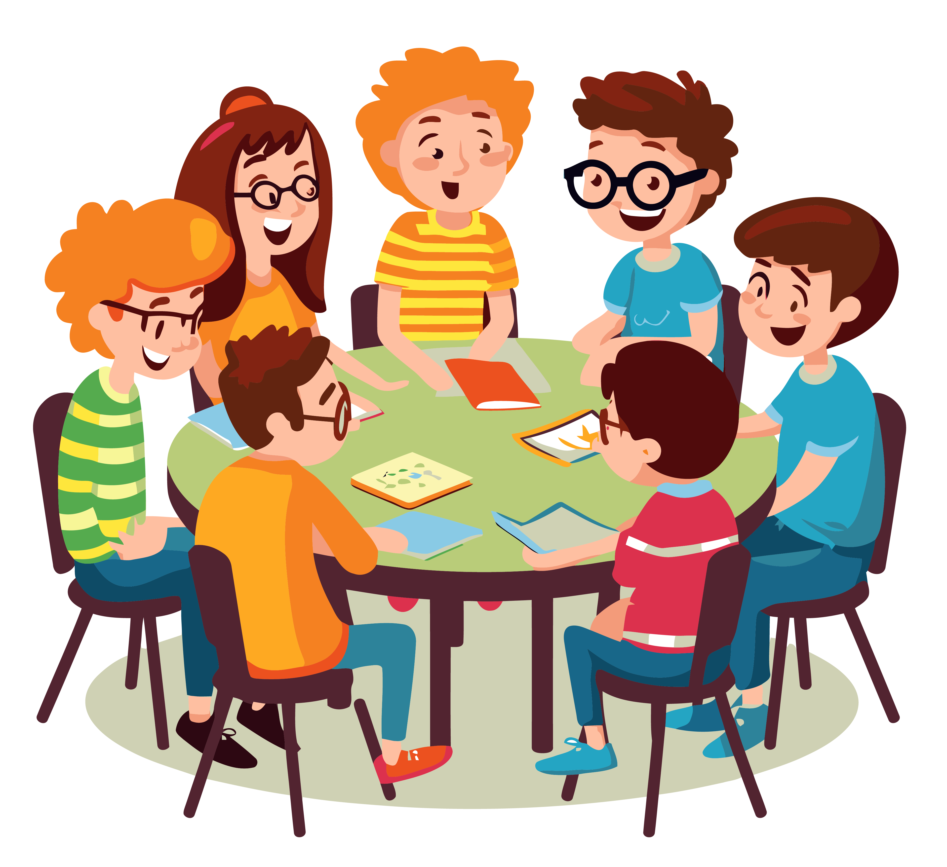
Talk with your partner about the animals you know, using can, could and may.
Practice
Group work

Slide 23
Summary
形容词的用法
情态动词 can/could/may

Slide 24
06
Assesment
Self-assessment
How well do you know about this lesson? Tick (√)the boxes.
I can learn some core words and expressions of the text. 口 口 口
② I can use adjectives and can, could and may correctly. 口 口 口

Slide 25
Homework
Must Do
1.背诵形容词的位置和用法，并用形容词描述你认识的动物;
2. 运用情态动词can, could 和may谈论你认识的动物.
Choose to Do
收集一些关于描述动物的形容词，了解词汇对应的图片或资料，与同学分享。

