Slide 1
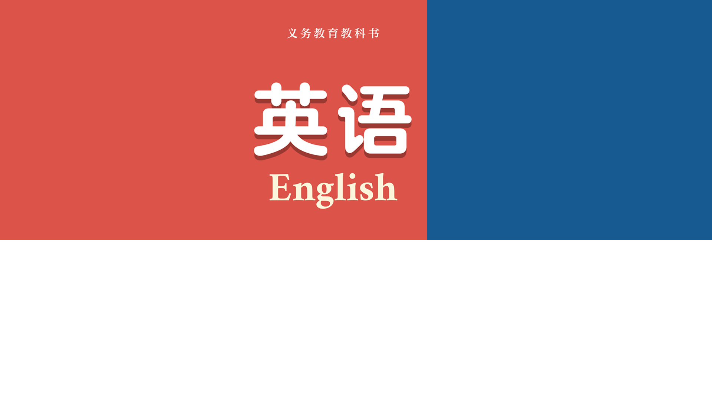
七年级下册
Unit 4 Chinese folk art!
Grammar

Slide 2
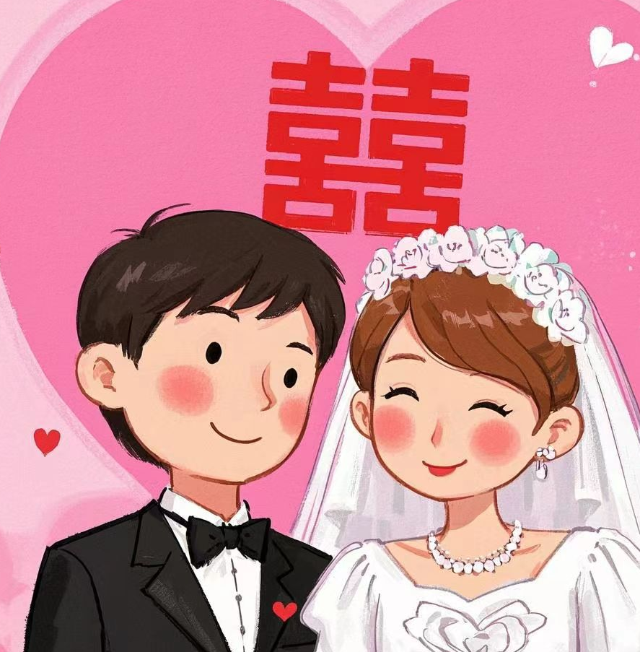
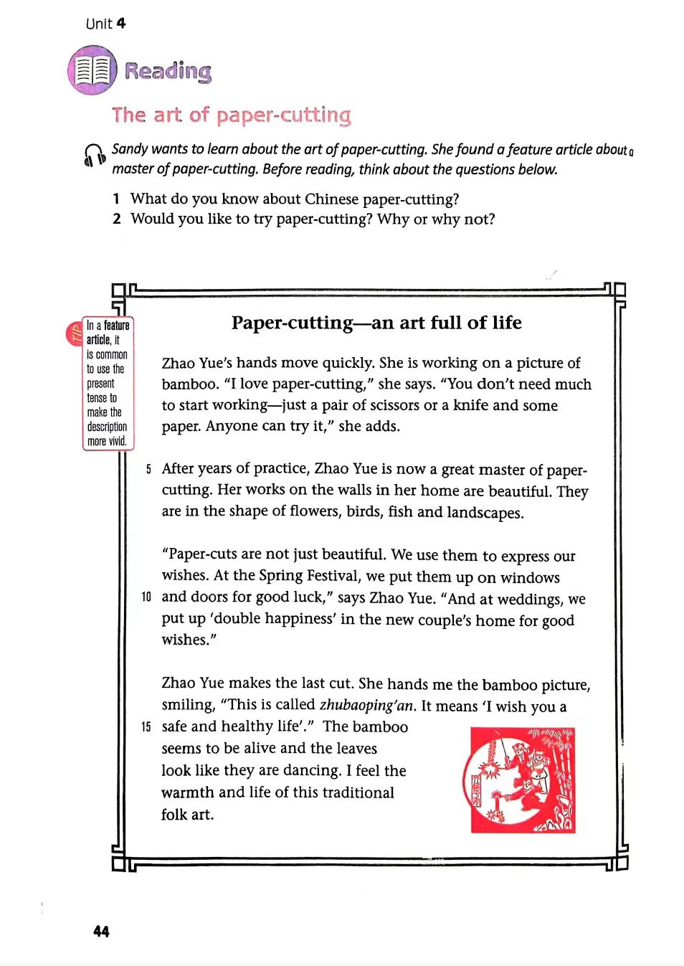
Lead-in：
Look at the picture and answer the following question.
1.Whose home will be put up “double happiness” at weddings?
2. Whose paper-cutting is it ?
The new couple’s.
Noun+'s 名词所有格's形式
Zhao Yue’s.

Slide 3
Presentation
Work out the rule!
Read the text below and pay attention to the use of ’s.
People often use paper-cuts to celebrate special events like weddings. For example, Zhao Yue's “double happiness” paper-cuts hang on the windows and walls of her cousin's home. People often put up this kind of paper-cut in a new couple's home to bring them happiness and good wishes.
Tips: We usually add ’s or ’to a noun to express the idea of belonging.

Slide 4
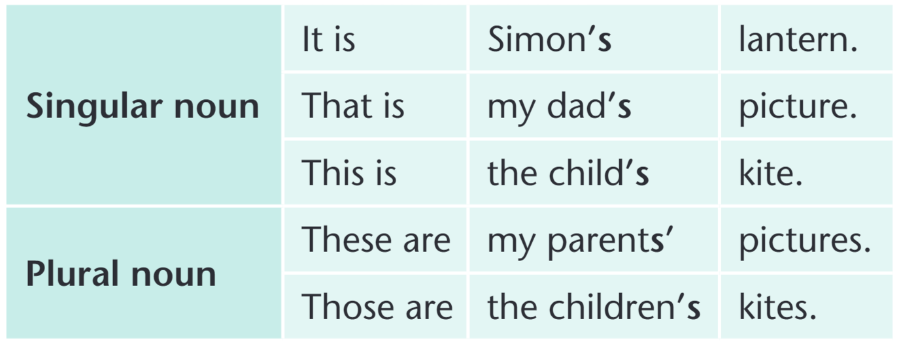
Presentation
We usually add ’s or ’ to a noun to express the idea of belonging:

Slide 5

Presentation
3. Finish “Work out the rule!” on page 47.
’s
·We usually add________( ’, ’s) to a singular noun.
·We usually add_______( ’, ’s) to a plural noun ending in -s.
·We usually add________(’,’s) to a plural noun that does not end in -s.
’
’s

Slide 6
Presentation
我们常用名词所有格来表达人或物的所有关系：
◆单数名词的所有格形式是在其后面加’s。
eg：这位妇女的女儿
the woman’s daughter
◆姓名的所有格形式是在其后加上’s。
eg：汤姆的姐姐
eg: 查尔斯的钢笔
Tom’s sister
Charles’s/Charles’s pen

Slide 7
Presentation
我们常用名词所有格来表达人或物的所有关系：
◆以s结尾的复数名词的所有格形式是在其后加上’。
eg：双胞胎的父母
学生们的家乡
◆ 不以s 结尾的不规则变化的名词复数，其所有格形式是在后面加’s。
eg：儿童节
eg: 中华人民共和国
the twins’ parents
the students’ hometown
Children’s Day
the People’s Republic of China

Slide 8
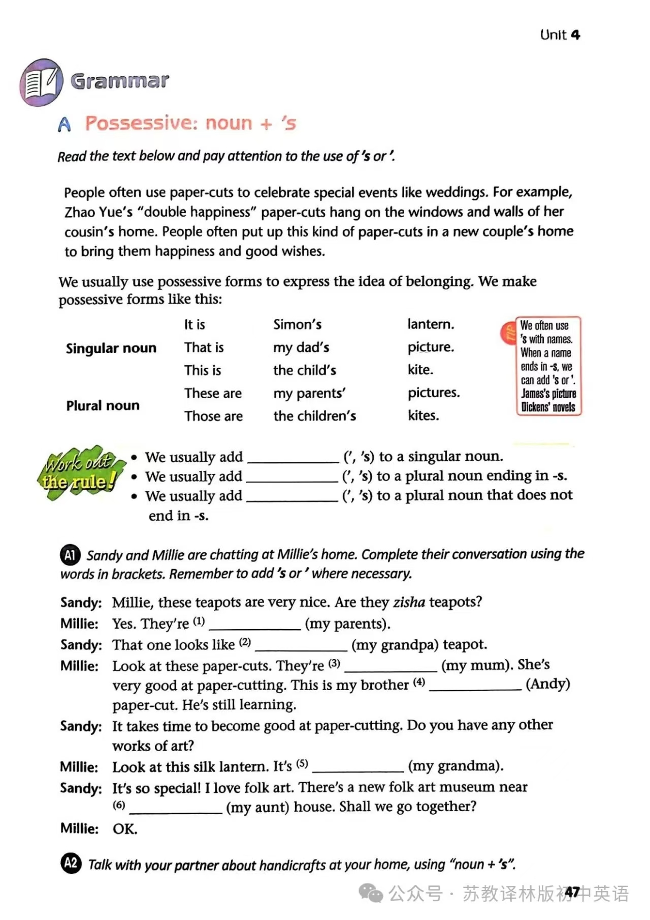
Practice
my parents'
my grandpa's
my mum's
Andy's
my grandma's
my aunt's

Slide 9
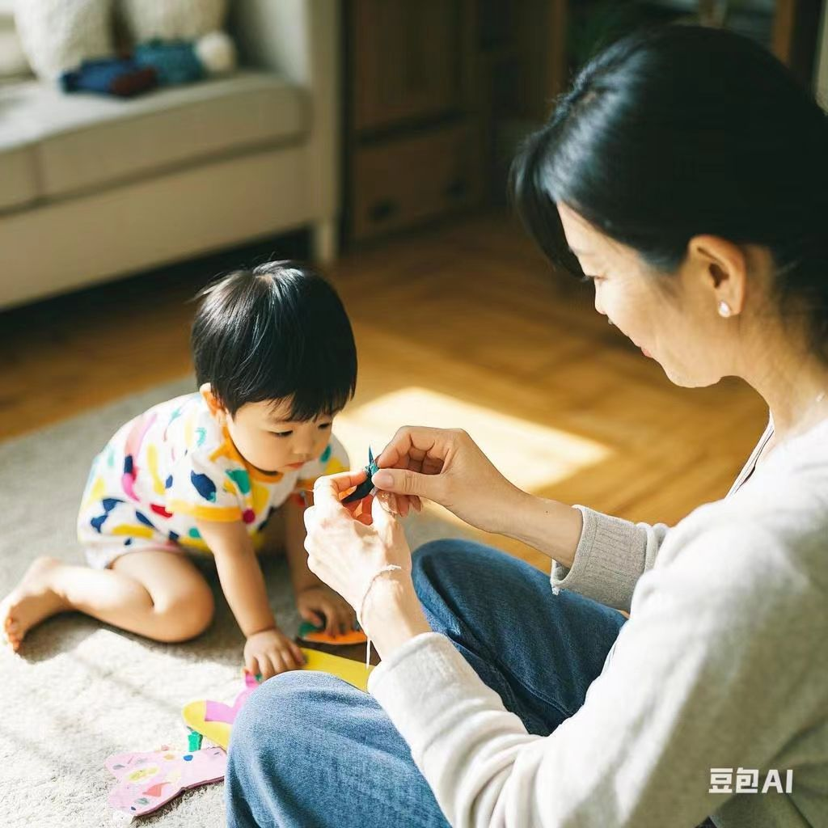
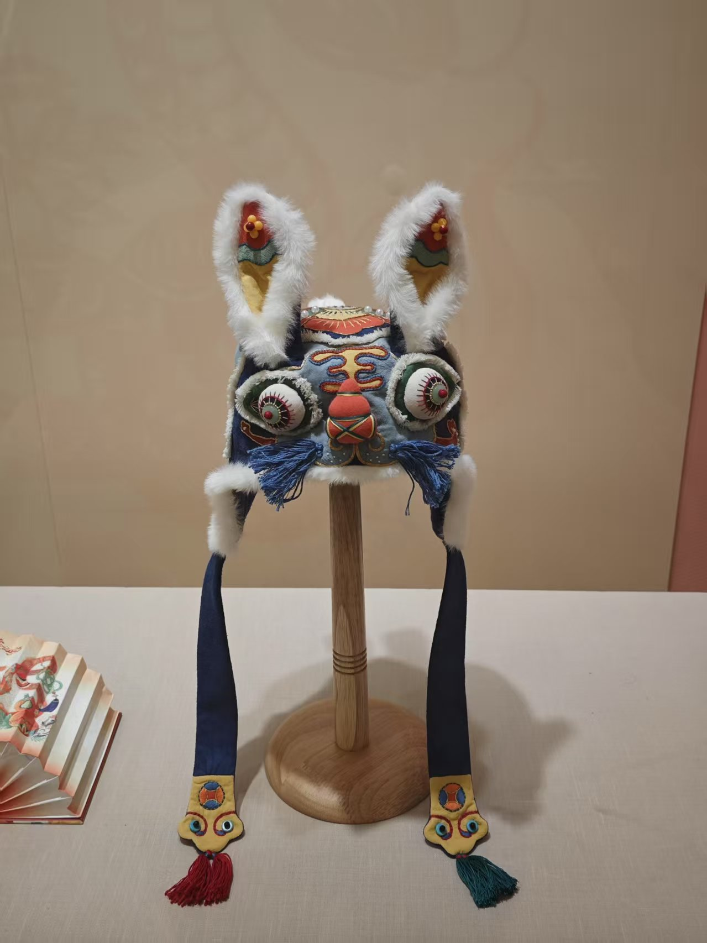
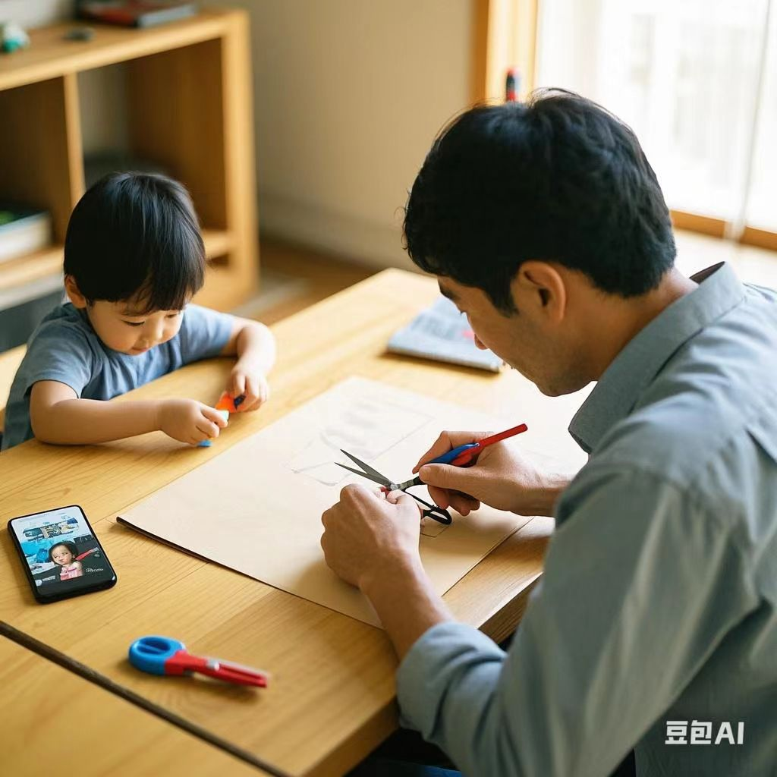
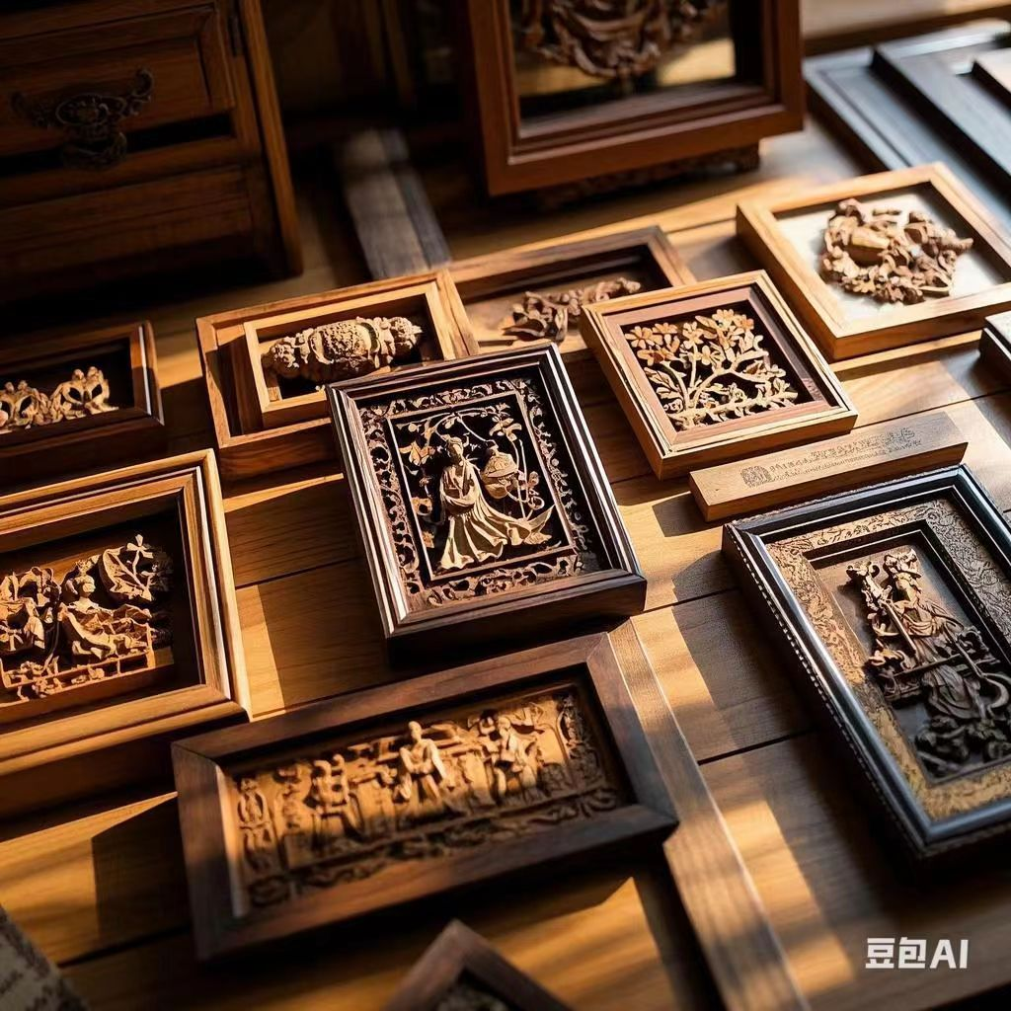
Production
This is my___handicraft.(mum)
It’s ____
These are my ___ woodcarvings. (dad)
They are ______

Slide 10
Presentation
Read the sentences below and pay attention to the use of possessive adjectives and pronouns.
I want my classmates to tell me about their favourite traditional crafts.
A friend of mine is teaching me how to do paper-cutting.
Millie does woodcarving with her father. His work is amazing. Hers is also good.
We are making lanterns to decorate our classroom.
Which are possessive adjectives and which are possessive pronouns?

Slide 11
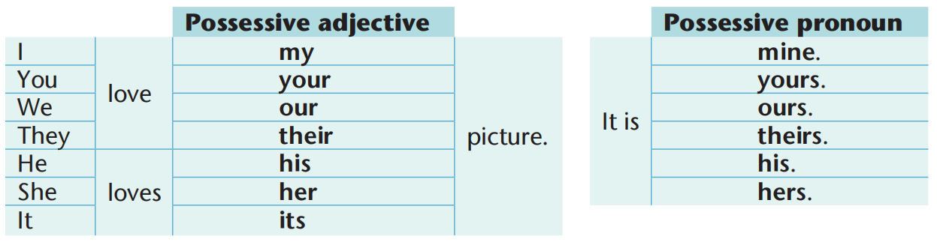
Presentation
Which are possessive adjectives and which are possessive pronouns?
before
· We use possessive adjectives________(before, after) nouns.
·We __________(use, don’t use) nouns after possessive pronouns.
don’t use

Slide 12
Presentation
我们常用形容词性物主代词和名词性物主代词来表示人或物的所有关：
eg ：This is my book.
These are our books.
eg: This book is mine.
These books are ours.
Tip1: 形容词性物主代词后一般带有名词。
Tip2: 名词性物主代词相当于“形容词性物主代词＋名词”。

Slide 13
Presentation
我们常用形容词性物主代词和名词性物主代词来表示人或物的所有关：
eg ：This is my book.
These are our books.
eg: This book is mine.
These books are ours.
Tip1: 形容词性物主代词后一般带有名词。
Tip2: 名词性物主代词相当于“形容词性物主代词＋名词”。

Slide 14
 | 第一人称 | 第二人称 | 第三人称 |  |  | 第一人称 | 第二人称 | 第三人称
形容词性物主代词 | my | your | his |  | its | our |  | their
名词性物主代词 | mine |  | his | hers |  |  | yours
单数
复数
her
your
yours
ours
theirs

Slide 15

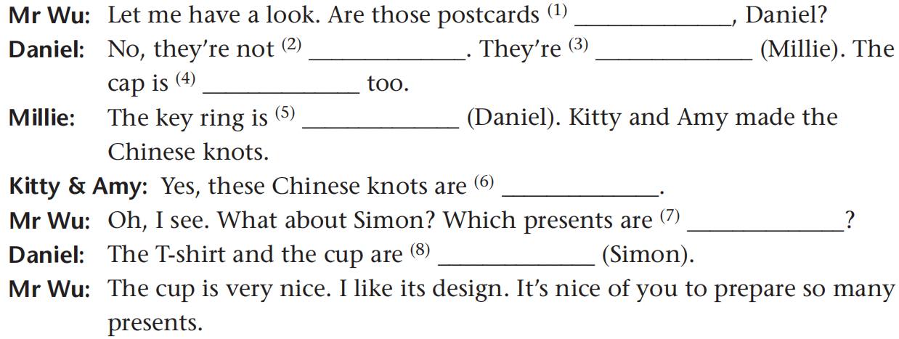
Practice
Now, look at the pictures and complete the conversation with the correct
possessive adjectives and pronouns, or the possessive forms of the nouns
in brackets.
yours
mine
Millie’s
hers
Daniel’s
ours
his
Simon’s

Slide 16
Practice
Fill in the blanks with pronouns:
  1.They are not my books. They are ____ .(he)
  2.Please give this to Susan. It is ____ ( she) pen.
  3.We are working hard on ____ (we) project.
  4.My flat is on the third floor. _____ (they) is on the tenth floor.
  5.I can’t find my ruler .Can I borrow ______ ( you)?
his
her
our
Theirs
yours

Slide 17
Practice
6.This is ____ (I) comic book. ______ (you) is over there.
7.Whose car is that ? It’s _______ (I).
8._______ (we) team will win the game.
9.Mrs Wang is _______ (he) English teacher.
10.The cat is _______(she). ______(it) hair is white.
my
Yours
mine
Our
his
hers
Its

Slide 18

1星题 语法通关
一、用所给词的适当形式填空。
1. ⁠(Peter) bicycle is black. He rides it to school every
day.
2. — Jim, may I borrow ⁠(you) dictionary?
— Oh, sorry. ⁠(my) is at home.
Peter’ s
your
Mine

Slide 19
China’ s
3. The Yellow River is ⁠(China) second longest
river(第二长河).
4. June 1st is a big day for ⁠ because it
is ⁠ Day.(child)
children
Children’ s

Slide 20
二、用方框中所给代词的适当形式填空。
we, they, she, he
5. — Are these balls yours, Daniel?
— No. You’ d better ask those boys. They are looking
for ⁠ .
6. David can't find ⁠ favorite postcard.
7. We are going to Paris to stay with a friend of ⁠ .
8. — Whose book is this?
— It's Lucy's. And the red pen is ⁠ , too.
theirs
his
ours
hers

Slide 21
三、单项填空。
( A )9. — What colour is dog?
— colour is black and white.
A
A. your; Its | B. you; Its
C. your; It | D. you; It
A
( A )10. The ten-year-old children are old enough to wash
own clothes, and Jack can wash by himself too.
A. their; his | B. theirs; his
C. their; he | D. theirs; he

Slide 22

D
( D )11. — It's rainy outside. Where is umbrella?
— Look! is over there, near the door.
A. my; You | B. mine; Yours
C. my; Your | D. my; Yours
B
( B )12. — Mike, is the hat on the bed ?
— No, it's my .
A. your; sister | B. yours; sister's
C. your; sister's | D. yours; sister

Slide 23
Homework
1.《课课练》P61-62 全部
2. 抄写背诵课本P45-47, 短语15个，3+1
3. 抄写背诵课本P48表格中物主代词，4+4

Slide 24

Thank you!

