Slide 1

Unit 2
Neighbourhood
Welcome to the unit

Slide 2
学习目标
To master some new words and phrases.
To learn about some jobs and work places.
To talk about your neighbourhood.

Slide 3
新课讲授
New words and phrases
neighbourhood
n.（AmE neighborhood） 街区；邻近的地方
officer
n.高级职员，官员
police officer
警察，警员
station
n.站，所，局
police station
警察局，派出所
restaurant
n.餐厅，餐馆

Slide 4
neighbour
n.（AmE neighbor） 邻居
above
prep.在（或向）……上面 adv.在（向）上面
lawyer
n.律师
law
n.法律，法规；规则
community
n.社区
from time to time
偶尔，不时

Slide 5



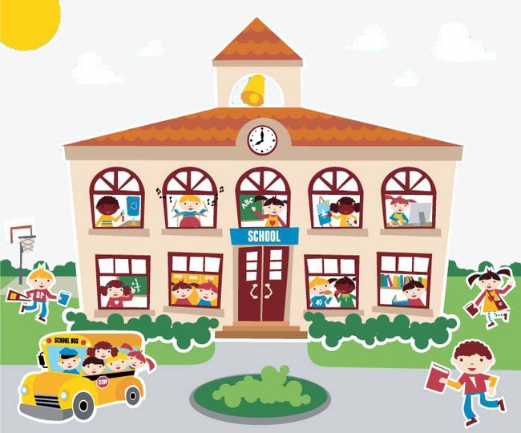


Free talk
What jobs and work places do you know?
hospital
医院
doctor
医生
nurse 护士
school 学校
teacher 老师
student 学生

Slide 6
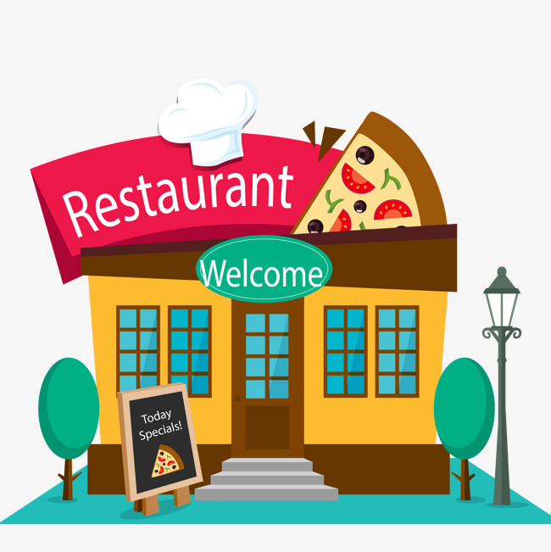
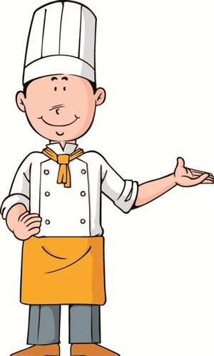

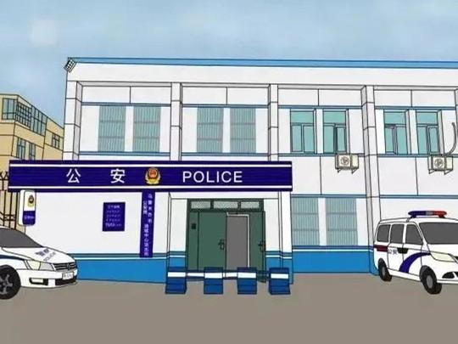

restaurant 餐馆
cook 厨师
waiter 服务员
police station
警察局
police officer
警察

Slide 7
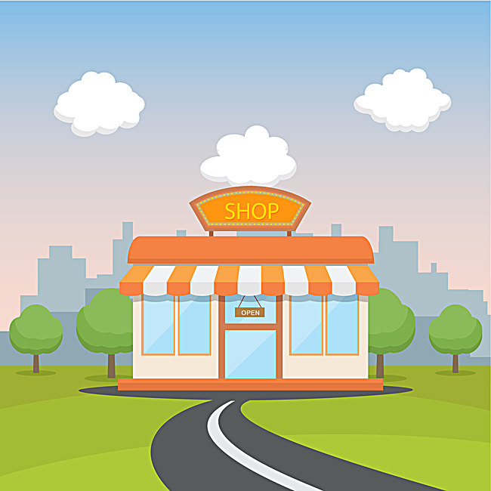
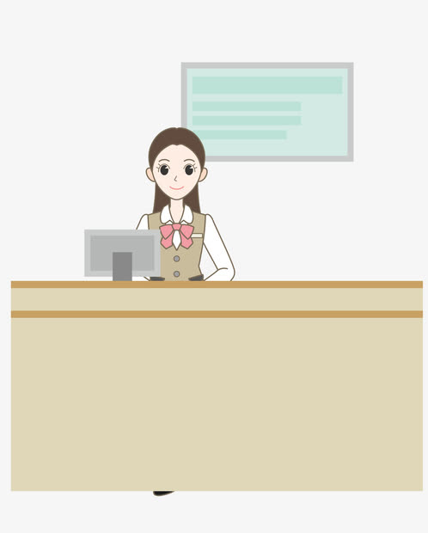

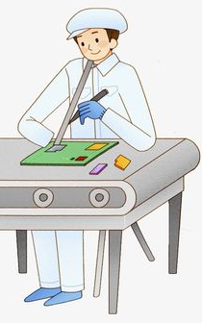
shop 商店
shopkeeper 售货员
factory 工厂
worker 工人

Slide 8
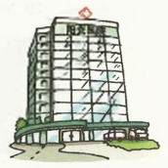
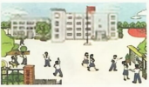
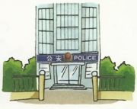
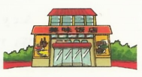
Listening
Listen to Simon talking about his neighbours. Write the correct job and work place under each person with the words in the box. Then match each person with the right picture.
cook doctor police officer teacher
hospital police station restaurant school
1 2
3 4
Mrs Huang
Job: ______________
Place: ______________
Mr Li
Job: ______________
Place: ______________
Ms Zhang
Job: ______________
Place: ______________
Mr Chen
Job: ______________
Place: ______________

Slide 9
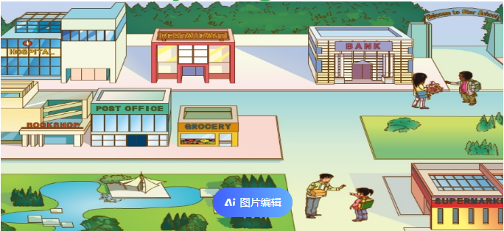
Free talk
What do you know about your neighbourhood?

Slide 10
Listening
Amy and Simon are talking about their neighbourhoods. Listen to the conversation and answer the questions.
1. What is Simon’s neighbourhood like?
2. What is Amy’s neighbourhood like?
It's nice. There's a school, a hospital and a big supermarket. He also has some lovely neighbours.
She also likes her neighbourhood. Her neighbours are very kind. They're always ready to help others.

Slide 11
Reading
Amy: What's your neighbourhood like?
Simon: It's nice. There's a school, a hospital and a big supermarket. I also have some lovely neighbours. What about you?
Amy: I also like my neighbourhood. My neighbours are very kind. They're always ready to help others.
Simon: How do they help?
Amy: Well, Mr Zhang lives above us. He's a lawyer. He helps us learn about laws at the community centre from time to time.
Simon: That's great!

Slide 12
Language points
1. What’s your neighbourhood like? 你的街区怎么样？
What+be+主语+like? 该句型意为“……是什么样的？”或“……怎么样？”,常用来询问某人的性格或品质,也可用于询问某物的特点。
e.g. —What is your mother like?你妈妈是什么样的人？
—She is quite kind.她相当善良。
—What’s your new school like?你的新学校怎么样？
—It’s big and clean.它又大又干净。

Slide 13
“What do/does+主语+look like?”意为“……长什么样？”,用于询问外貌。答语有①主语+be+描述外貌的形容词.
②主语+have/has+形容词+名词.
③主语+be+of...height/build.
e.g. —What does your sister look like？你姐姐长什么样？
—She is very thin and of medium height. She has short
curly hair. 她很瘦,中等身高,留着短短的卷发。

Slide 14
2. There’s a school, a hospital and a big supermarket.
有一所学校、一家医院和一家大超市。
在there be结构中，如果动词be后面的主语是两个或两个以上的名词，be动词的单复数形式要与离它最近的名词
保持一致，即遵循“就近原则”。
e.g. There is a pen, two books and many pencils on the desk.
课桌上有一支钢笔、两本书和许多铅笔。
There are two books, a pen and many pencils on the desk.
课桌上有两本书,一支钢笔和许多铅笔。

Slide 15
3. They're always ready to help others. 他们总是乐于助人。
be ready to do sth. 愿意（乐于）做某事，准备好做某事
e.g. Right, we're ready to go.
对，我们准备好了，可以走了。
be ready for sth. 为某事准备好
e.g. The students are ready for the basketball match.
学生们为篮球赛做好了准备。

Slide 16
4. Well, Mr Zhang lives above us.
嗯，张先生住在我们楼上。
(1) above作介词，意为“在（或向）……上面”，不一定在正上方，没有接触面。
e.g. There is a light above my desk.
在我桌子的上方有一盏灯。

Slide 17
辨析：on, over与above
on | 表示一物在另一物的表面上，强调两者接触。 | There is a cup on the table. 桌上有个杯子。
over | 表示一物在另一物的正上方，两者不接触，对应词是under。 | There is a bridge over the river. 河上有座桥。
above | 表示一物在另一物的上方，不一定是正上方，两者不接触，对应词是below。 | The moon was above the tall tree in the east. 月亮挂在东方的高树上。

Slide 18
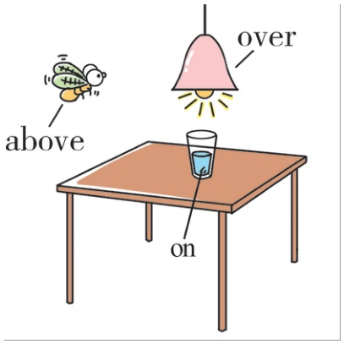
【图解记忆】
【语境串记】Look! A boy is drawing on the bridge which is over the river. And there is a plane above his head. 看！一个男孩正在河上的桥上画画。他头顶上有一架飞机。

Slide 19
(2) ［副词］在（或向）上面
e.g. Put it on the shelf above.
把它放到上面的搁板上。
拓展：above的反义词是below，作介词意为“在（或到）……下面”；作副词意为“在（或到）下面”。
e.g. There is a chair below the window.
窗户下有一把椅子。
They live on the floor below.
他们住在下一层楼。

Slide 20
5. He helps us learn about laws at the community centre from time to time. 他偶尔会在社区中心帮助我们了解法律。
(1) law（lawyer［名词］律师）/lɔ:/ n.法律,法规;规则
常用短语：break the law 违反法律 obey the law 遵守法律
make laws 制定法律 by law 按照法律规定
【语境串记】Mr. Li is a famous lawyer. He always tells us that we should obey the law. If we break the law, we’ll be
punished ..by law. 李先生是一位著名的律师。他总是叮嘱
我们应该遵守法律。如果我们违法, 按照法律规定我们将
会受到惩罚。

Slide 21
from time to time意为“偶尔，不时”，在句中作时间状语，相当于at times或sometimes。
e.g. My grandmother can’t find her glasses from time to time.
我奶奶有时找不到她的眼镜。
拓展：与time相关的其他短语/搭配
at the same time同时 all the time始终,一直
at times有时；间或 once upon a time从前
in no time立刻,马上 at a time每次,逐一
have a good time玩得开心 on time准时,按时
at all times总是 in time及时
for the first time首次,第一次

Slide 22
Role-play
Amy: What's your neighbourhood like?
Simon: It's nice. There's a school, a hospital and a big supermarket. I also have some lovely neighbours. What about you?
Amy: I also like my neighbourhood. My neighbours are very kind. They're always ready to help others.
Simon: How do they help?
Amy: Well, Mr Zhang lives above us. He's a lawyer. He helps us learn about laws at the community centre from time to time.
Simon: That's great!

Slide 23
Speaking
Work in pairs and talk about your neighbourhoods. Use the conversation below as a model.
A: What's your neighbourhood like?
B: It's ... There's/re ... I also have ... What about you?
A: I ... my neighbourhood. My neighbours are ... They're ...
B: How do they ...?
A: Well, ... live(s) ... She/He's .... She/He ...
B: That's ...!

Slide 24



5
Show time

Slide 25
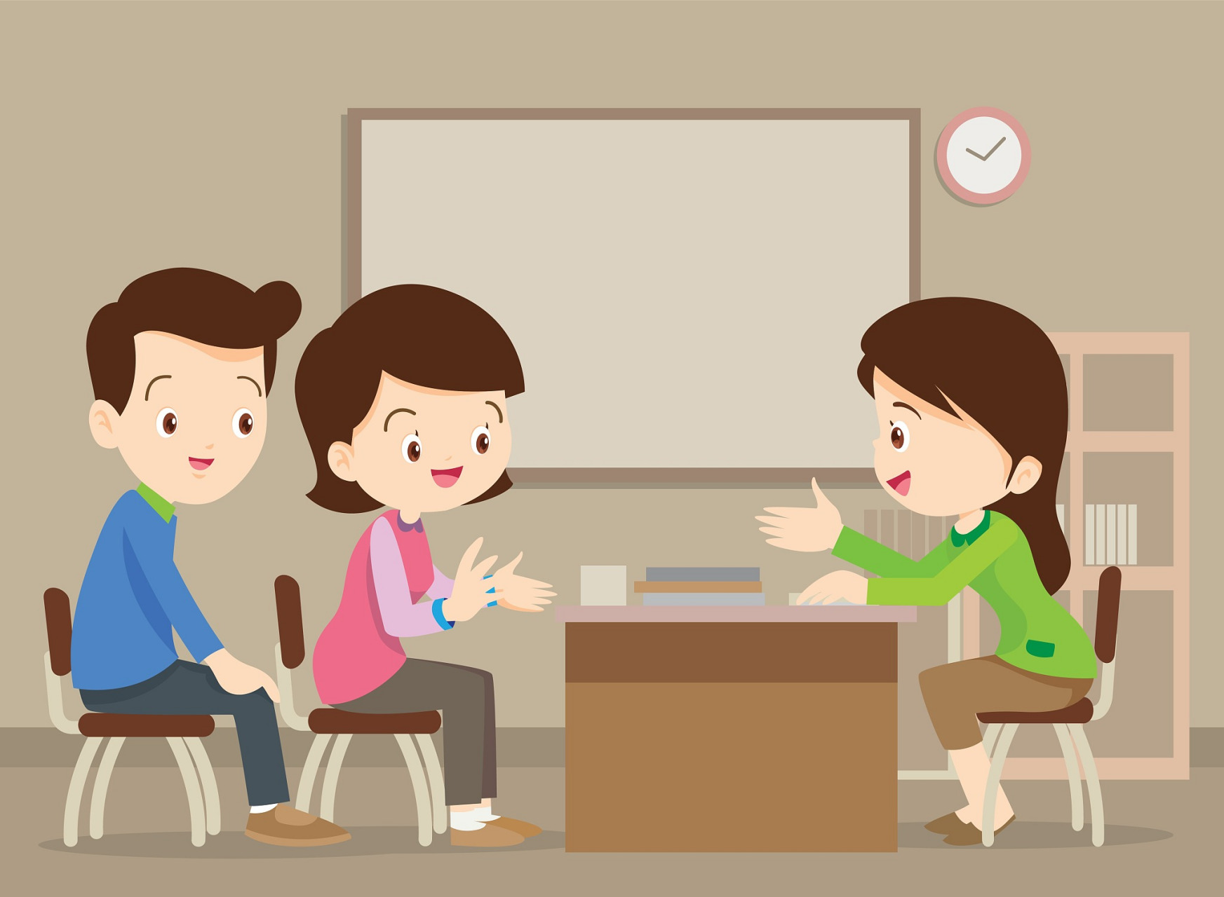
What are your neighbours like? Talk to your classmates about one or two of them.

Slide 26
当堂检测
一、根据句意及所给中文提示或首字母，写出句中所缺单词
1. He put a pot a __________ the fire to cook soup.
2. The police o helped the old man find his lost money.
3. Walk along this road and you will see the police s next to the hospital.
4. The dishes in the _____________ (餐馆) are very delicious. You should have a try.
5. Everyone is working hard to make our ____________ (社区) a better place to live in.
6. My uncle is a __________ (律师) and I learned a lot about l . from him.
7. This woman often shares food with her _______________________ (邻居) and they are also kind to her.
bove
fficer
tation
restaurant
community
lawyer
aws
neighbours / neighbors

Slide 27
二、从方框中选择适当的短语，并用其正确形式填空
from time to time learn about be ready to be like
1. I am interested in reading books. I can _______________ different cultures and histories in that way.
2. She __________ always __________ help others whenever they need help.
3. Sam and his grandparents live in different neighbourhoods, but he visits them ____________________.
4. Let’s share what our neighbours __________ and how we can make our community better.
learn about
is ready to
from time to time
are like

