Slide 1
Unit 2
Neighbourhood
Reading

Slide 2
学习目标
1. To master some new words and phrases.
2. To know more about Simon’s community through reading.
3. To talk about your opinions about your neighbourhood.

Slide 3
新课讲授
New words and phrases
volunteer
n.志愿者 vi.&vt.自愿做，义务做，无偿做
laptop
n.笔记本电脑
engineer
n.工程师
check
vt.& n.检查，核查
broken
adj.出了毛病的，破损的
someone
pron.（＝somebody） 某人
repair
vt.&n.修理

Slide 4
pron.（＝anybody） 任何人
n.学院；＜美＞大学
adj.愿意，乐意
乐意做某事
vt.&vi.使整洁，整理
det.&pron.如此；这样的
adv.在任何时候
anyone
college
willing
be willing to do sth.
tidy
such
any time

Slide 5
Revision
What have we learned about Simon’s community?
It's nice. There's a school, a hospital and a big supermarket. He also has some lovely neighbours.

Slide 6
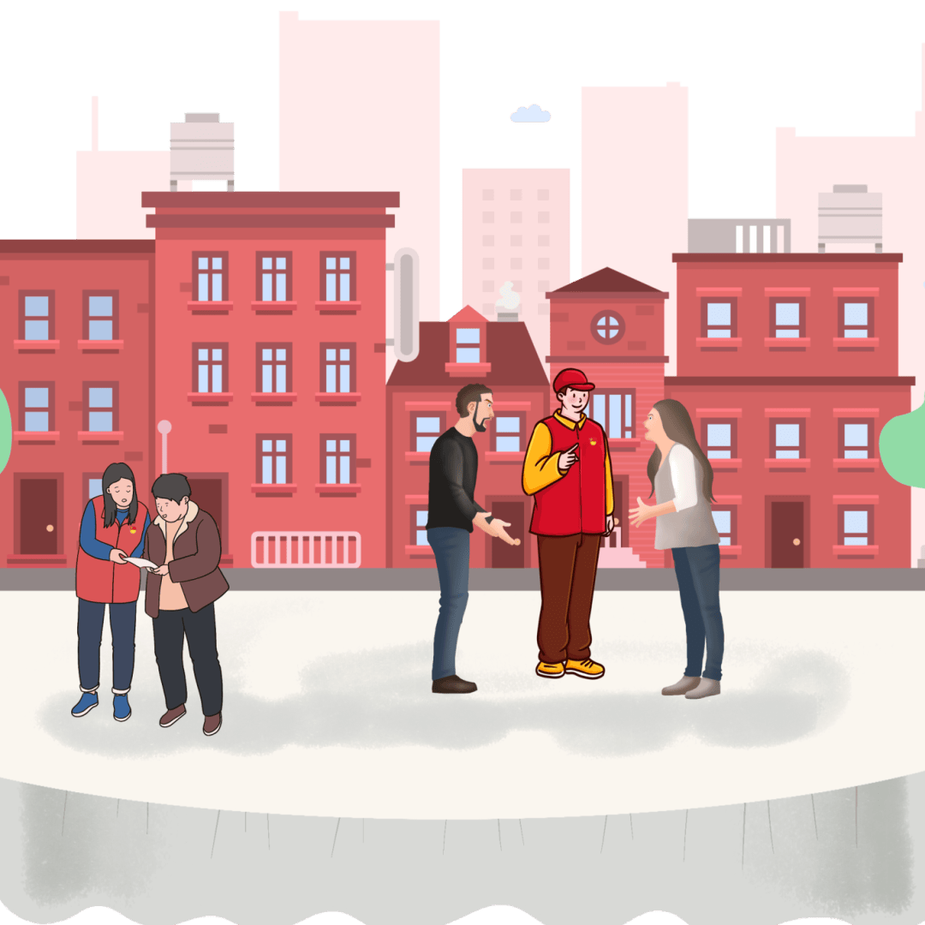
Pre-reading
Amy wants to learn more about Simon's community. Here is their conversation. Before reading, think about the questions below.
1 What activities do you have in your community?
2 How can you help your community?

Slide 7
While-reading
Skim the conversation and answer the question below.
From what aspects (方面) do they talk about Simon’s neighbourhood
① What Simon’s neighbours are like
② When and where volunteers in Simon’s neighbourhood meet
③ What volunteers in Simon’s neighbourhood will do at the weekend

Slide 8
Scan the passage and complete the chart about the volunteers in Simon's neighbourhood.
community centre
Kind
(1) ____________
At the (2) ____________
at the weekend
helpful
What they are like
When and where they meet
Volunteers in Simon's
neighbourhood
What they will do at the weekend
computers
Check (3) ____________
Repair (4) ____________ things like bikes
Help kids with their homework
Visit and help old people
broken
some shopping
Do (5) ____________ for them
Help (6) ____________ their flats
tidy

Slide 9
Read the conversation again, Write a T if a sentence is true or an F if it is false. Then correct the false ones.
Volunteers share their skills and help people in the neighbourhood with different problems.
2. Usually the volunteers have a meeting during the week.
3. Simon wants to ask someone to fix his bicycle this weekend.
4. One of the volunteers is a computer engineer.
5. College students help the children do sport at the community centre.
6. Volunteers also help the old people.
______
______
______
______
______
______
T
F
at the weekend
F
check his laptop
T
F
homework
T

Slide 10
Simon's community centre needs more volunteers to help. Complete the centre's notice with the correct forms of the words and phrases in the box below.
college community engineer neighbour
repair tidy volunteer willing to
We need you!
Do you have any free time? Are you (1) ____________ help others? why not be a(n) (2) ____________ at our community centre? There are many ways to help!
Planning parties
The people here are all very nice. A tea party or a day out together will be great for (3) ____________ to know more about each other. Join us and we can plan these activities together!
willing to
volunteer
neighbours

Slide 11
Helping hands
Are you a computer (4) ____________? Do you know how to fix a laptop? Or can you (5) ____________ things like a broken bike? Or are you a(n) (6) ____________ student? Do you want to help kids with their homework? Or would you like to help the old people (7) ____________ their flats? We need volunteers like these. Join us and give back to our community.
Let's clean up!
We are very lucky to live in such a lovely neighbourhood. Let's keep it looking nice. Can you join us to clean up the park in our (8) ____________ this Saturday morning?
Please email us to be a part of our team. We are happy to have you with us any time.
engineer
repair
college
tidy
community

Slide 12
Post-reading
Think about the questions below. Share your answers with your classmates.
1 What kind of volunteer work can you do in your neighbourhood?
2 What do you like best about your community?
3 What do you think makes a neighbourhood a good place to live in?

Slide 13
Language points
1. They help us with all kinds of problems.
他们帮助我们解决各种各样的问题。
(1) help 可以是动词和名词，用法如下：
help sb. with sth. 帮助某人解决某种困难
help sb. do sth. 帮助某人做某事
with one's help 在某人的帮助下
e.g. He always helps me with my homework.
他总是帮助我做作业。
(2) all kinds of 各种各样的
e.g. They sell all kinds of things.
他们出售各种各样的东西。

Slide 14
2. Are you going to ask for help this weekend?
这个周末你要寻求帮助吗？
(1) “be going to将要,打算”，可以用be going to来谈论即将发生的事情,to后接动词原形。此处是含有be going to结构的一般疑问句。
e.g. I want to be a doctor and I’m going to study Chinese medicine.我想成为一名医生,并且我打算学习中医。
(2) ask (sb.) for sth.（向某人）请求得到某物
ask (sb.) for help（向某人）请求帮助
ask (sb.) for advice（向某人）征询建议
ask sb. (not) to do sth. 要求某人（不）做某事
e.g. Some people find it difficult to ask for help.
有些人觉得很难开口叫别人帮忙。

Slide 15
3. There’s something wrong with my laptop.
我的笔记本电脑出故障了。
There is something wrong with...相当于Something is wrong with...，意思是“……不正常”。
e.g. There's something wrong with my watch.
=Something is wrong with my watch.
我的手表坏了。
拓展：表达“某物坏/失灵了”还可用如下句型
... is/are not working well.
... doesn’t/don’t work.
... is/are broken.

Slide 16
若想表达“……没问题”，可以用There is nothing wrong with...或There isn’t anything wrong with...。
e.g. There is nothing wrong with your TV set.
=There isn’t anything wrong with your TV set.
你的电视机没毛病。
该句型的一般疑问句为“Is there anything wrong
with ...?”。
e.g. Is there anything wrong with your TV set?
你的电视机出问题了吗？

Slide 17
4. My sister Annie’s bicycle is broken, so she's going to have someone repair it. 我妹妹安妮的自行车坏了，所以她要找人修理。
(1) 该句是由so连接两个并列分句，第一分句为表示原因的“主语+系动词be+表语”结构，第二分句为表示结果的“主语+be going to+动词原形+其他”结构。
(2) have在此作使役动词，have sb. do sth. 让某人做某事
e.g. I had her clean the room. 我让她打扫了房间。

Slide 18
5. Some college students are willing to help.
一些大学生乐意帮忙。
be willing to do sth意为“乐意做某事”，其中willing作形容词，意为“愿意，乐意”
e.g. She is willing to share things with her friends.
她愿意和她的朋友分享东西。
be ready to do sth也可意为“愿意做某事”，相当于be willing to do sth。
e.g. Mary is always ready to help others.
玛丽总是乐于助人。

Slide 19
6. Do the old people get any help as well?
老人也会得到帮忙吗？
as well 也，还，除……之外
e.g. Simon will go to the library tomorrow as well.
西蒙明天也将去图书馆。

Slide 20
7. The volunteers often visit the old people and do some shopping for them.
志愿者经常看望老人，给他们买东西。
do some shopping 买东西，购物
do some/the + v-ing短语结构常用来泛指做某类事情
e.g. We often do some cleaning on Friday afternoon.
周五下午我们经常打扫卫生。
When you have time, you should do some reading.
当你有时间的时候，你应该读些书。

Slide 21
8. You’re lucky to live in such a nice neighbourhood, Simon.
西蒙，你住在这么好的社区真幸运。
(1) be+形容词+to do sth. 做某事是……
e.g. I am happy to help you. 帮到你我很开心。
(2) 辨析such与so
such | 限定词 | such+a/an+adj.+可数名词单数
 |  | such+adj.+可数名词复数/不可数名词
so | 副词 | so+adj./adv.
 |  | so+adj.+a/an+可数名词单数
 |  | so+many/much/few/little+名词

Slide 22
e.g. She’s such a little monkey.
她真是一个小捣蛋鬼。
It’s a pity to waste such delicious food.
浪费这么好吃的食物真是可惜。
They all looked so nice and cute.
她们看起来都这么漂亮可爱。
She is so nice a girl.
她是一个如此好的女孩。
I’m afraid so little water won’t be enough to drink.
就这么点儿水,我怕不够喝。

Slide 23
【特别提醒】
“such+a/an+adj.+可数名词单数”可与“so+adj.+a/an+可数名词单数”进行转换。
e.g. It is such a nice gift. = It is so nice a gift.
它是一个如此漂亮的礼物。

Slide 24
9. Why not be a volunteer at our community centre？ 为什么不做我们社区中心的一名志愿者呢？
“Why not do sth？” 意为“为什么不做某事呢？”，常用于提出建议，相当于“Why don’t you do sth？”。
e.g. Why not make a card by yourself？
＝Why don’t you make a card by yourself？
你为什么不自己制作一张卡片呢？

Slide 25
10. Join us and give back to our community.
加入我们，回馈我们的社区。
give back to 回馈；归还；反馈
e.g. I want to give back to my friends who have always supported me.
我想回报那些一直支持我的朋友。

Slide 26
11. Can you join us to clean up the park in our community this Saturday morning?
这个星期六早上你能和我们一起把我们社区的公园打扫干净吗？
clean up 打扫干净，收拾干净
e.g. You should always clean up the room.
你应该经常把房间收拾干净。

Slide 27
当堂检测
一．根据句意及所给中文提示或首字母，写出句中所缺单词
1. ________________ (志愿者) were busy working together to clean the snow on the streets .
2. There is something wrong with my ____________ (笔记本电脑). I’m going to have ________________ (某人) c it.
3. You can ask an __________ (工程师)to help r . the b . computer for you.
4. Would ____________________ (任何人) like to live in s a modern community?
5. The __________ (大学) students help the old t their houses.
Volunteers
laptop
someone/somebody
heck
engineer
epair
roken
anyone / anybody
uch
college
idy

Slide 28
二、从方框中选择适当的短语，并用其正确形式填空
help... with any time be lucky to helping hand willing to clean up
1. I am happy to help people in need _______________.
2. You _______________ live in a community like this.
3. The engineers often _______________ us _______________ all kinds of problems.
4. Can you give a _______________ to tidy the classroom on Friday afternoon?
5. His mother is _______________ get up early and prepare a delicious breakfast for him.
6. Can you join us _______________ the park tomorrow morning?
any time
are lucky to
help with
helping hand
willing to
to clean up

