Slide 1
Neighborhood
Unit 2
Welcome to the Unit

Slide 2
Learning aims
能识别并掌握一些职业及工作场所的名称
能用简单的英语谈论自己所居住的社区

Slide 3
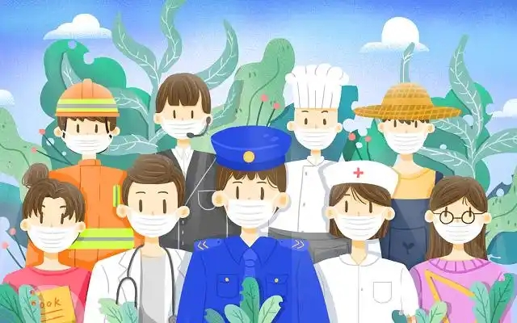
Lead in
Free talk
—What are you going to be in the future?
—I’m going to be a...
—Where are you going to work?
—I’m going to work at/in…

Slide 4
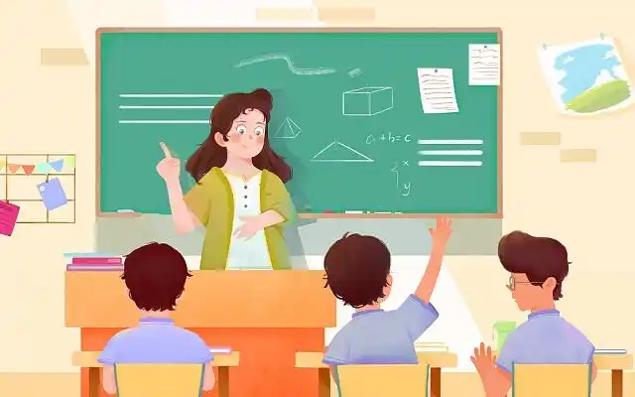
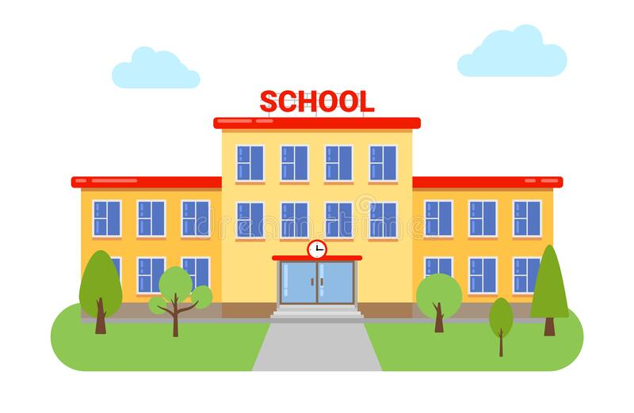
Activity 1
Talk about job and workplace
Learn the names of job and workplace
teacher
students
school

Slide 5
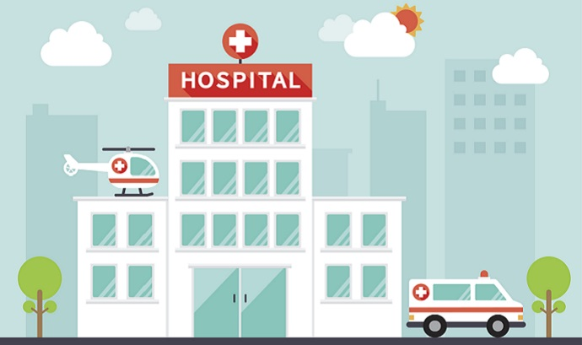
doctor
nurse
hospital

Slide 6
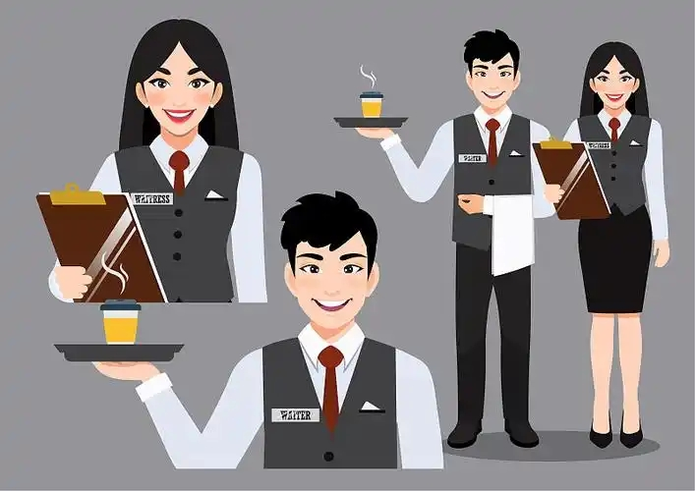
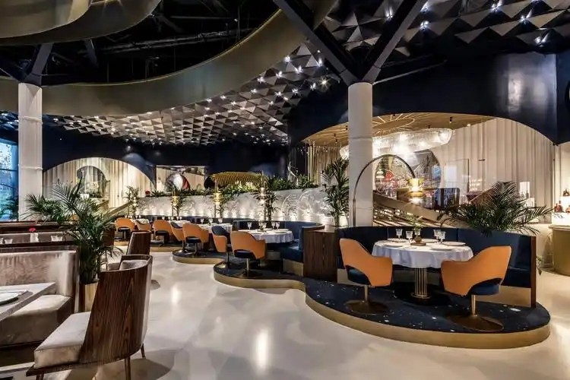
cook
waitress/waiter
restaurant

Slide 7
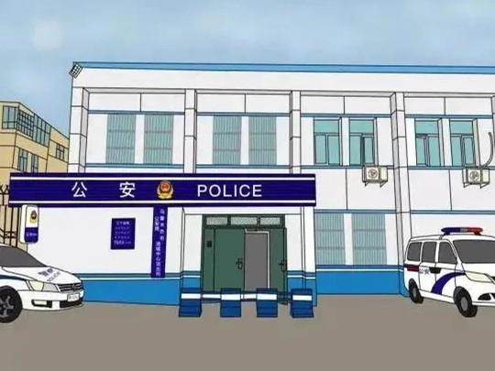
police officer
police station

Slide 8
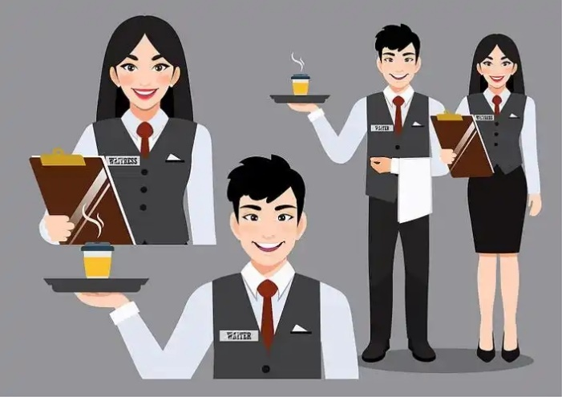
Sharp eyes

Slide 9
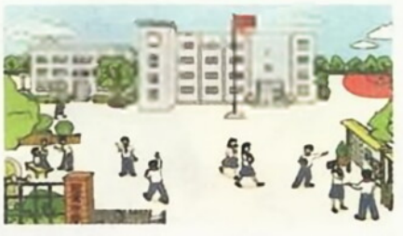
A Listen to Simon talking about his neighbours. Write the correct job and work place under each person with the words in the box. Then match each person with the right picture.
cook doctor police officer teacher
hospital police station restaurant school
Mrs Huang
Job: ___________________
Place: __________________
teacher
school

Slide 10
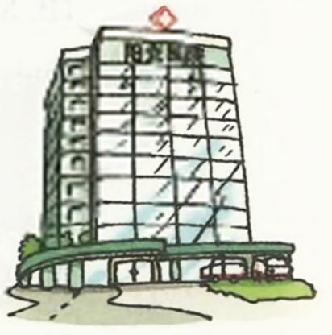
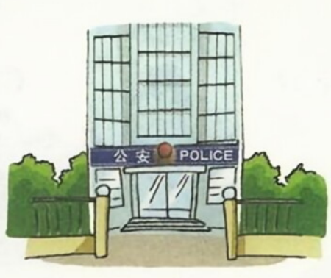
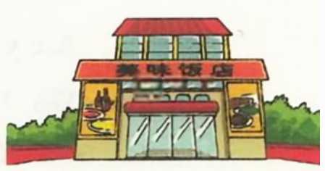
Mr Li
Job: ____________________
Place: ___________________
doctor
hospital
Ms Zhang
Job: ____________________
Place: ___________________
police officer
police station
Mr Chen
Job: ____________________
Place: ___________________
cook
restaurant

Slide 11
Talk about the job and work place in A.
Mrs Huang
Mr Li
Ms Zhang
Mr Chen
A: What does …do?/What is…?
B: He/ She is a…
A: Where does …work?
B: He/ She works at/in…

Slide 12
Activity 2
Talk about your neighbourhood and neighbours
Read the conversation in B and answer the questions.
Amy: What’s your neighbourhood like?
Simon: It’s nice. There’s a school, a hospital and a big supermarket. I also have some lovely neighbours. What about you?
Amy: I also like my neighbourhood. My neighbours are very kind. They’re always ready to help others.
Simon: How do they help?
Amy: Well, Mr Zhang lives above us. He’s a lawyer. He helps us learn about laws at the community centre from time to time.
Simon: That’s great!

Slide 13
1 What’s in Simon’s neighbourhood?
2 What are Simon’s neighbours like?
3 What are Amy’s neighbours like?
4 What does Mr Zhang do?
There’s a school, a hospital and a big supermarket.
They are lovely.
They are very kind.
He is a lawyer.

Slide 14
Work in pairs and talk about your neighbourhoods. Use the conversation in B as a model.
What’s your neighbourhood like?
It’s ...

Slide 15
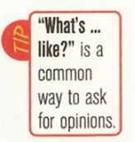
Language points
1 What’s your neighbourhood like?
What’s …like? 通常用来询问对方对某事物的看法
What’s your house like?

Slide 16
2 They’re always ready to help others.
be ready to do sth. 准备好做某事
She is ready to go home.
3 He helps us learn about laws at the community centre from time to time.
learn about sth. 学习……
from time to time 不时地

Slide 17
C What are your neighbours like? Talk to your classmates about one or two of them.

Slide 18
Summary
◆重点词汇
cook, doctor, police officer, teacher, hospital, police station, restaurant, school
be ready to do sth., learn about, from time to time
◆重点句式
1 What’s your neighbourhood like?
2 There’s a school, a hospital and a big supermarket.
3 They’re always ready to help others.

Slide 19
Exercise
单项选择
1 He is a ______________. He works in the police station.
A. teacher B. cook C. police officer D. doctor
2 — __________ your city like?
—It’s beautiful.
A. What’s B. Where’s C. Why’s D. How’s
3 She is very ___________. She’s aways ready __________ her neighbours.
A. kind; help B. kind; to help C. nice; help D. nice; helping
C
A
B

Slide 20
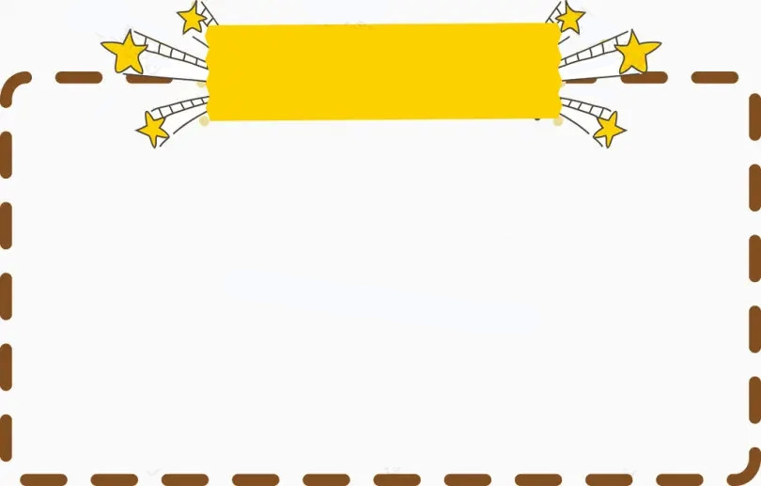
Homework
1 Write down the words in A three times each.
2 Make a conversation about your neighbours.

