Slide 1
Neighbourhood
Unit 2
Reading

Slide 2
Learning aims
能正确运用本课时的重点词汇，如helpful，volunteer, skill, all kinds of, laptop, computer engineer, check, repair, college student等
能用英语介绍社区中心的活动内容
能建立邻里间互帮互助的理念

Slide 3
Lead in
A near neighbour is better than a distant cousin.
远亲不如近邻。
Do you have any neighbours?
What are your neighbours like?

Slide 4
Activity 1
Learn to express activities in the community
Predict(预测)：What will Amy and Simon talk about?
Good neighbours
Pay attention to the title!

Slide 5
Skimming
Choose the main idea of the dialogue (对话).
An engineer helps Simon check his computer.
There is a community center in Simon’s neighbourhood.
College students are ready (乐意的) to help children with their homework.
D. Simon’s neighbours share their skills to help people in need in the neighbourhood.
√

Slide 6
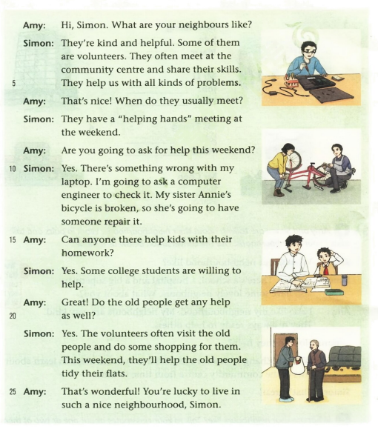
Read for structure
Pre-reading
Part1
Structure
Part2
Part3
A. Simon’s neighbours’ qualities 特征
B. Feelings to live there
C. Simon’s neighbours’ help

Slide 7
While reading
Read the first part (lines 1-8) and answer the questions.
Who?
When?
The volunteers.
At the weekend.
They want to share their different skills and help people with all kinds of problems.
At the community centre.
Why?
Where?

Slide 8
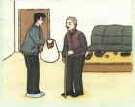
Read lines 8-19. Try to finish the table.
People | Problems | How do the volunteers help them?
There is something wrong with Simon’s computer
check the computer
Annie’s bicycle is broken.
help the girl fix her bicycle
Homework
is difficult
help the students with their
homework
The old people
need help.
visit them; do some shopping; clean their flats

Slide 9
A Complete the chart about the volunteers in Simon’s neighbourhood.
· At the (2) ________________
at the weekend
· Kind
community centre
· (1) __________
helpful
What they are like
When and where they meet
Volunteers in Simon’s neighbourhood
What they will do at the weekend
laptops/ computers
· Check (3) ________________
· Repair (4) ________________ things like bikes
· Help kids with their homework
· Visit and help old people
broken
some shopping
Do (5) _________________ for them
clean
Help (6) _______________ their flats

Slide 10
B Read the conversation again. Write a T if a sentence is true or an F if it is false. Then correct the false ones.
1 Volunteers share their skills and help people in the neighbourhood
with different problems.
2 Usually the volunteers have a meeting during the week.
3 Simon wants to ask someone to fix his bicycle this weekend.
4 One of the volunteers is a computer engineer.
5 College students help the children do sport at the community centre.
6 Volunteers also help the old people.
______
T
______
at the weekend
F
______
F
laptop
______
T
F
______
homework
______
T

Slide 11
Language points
1 They’re kind and helpful.
helpful
adj.
有帮助的;有用的;有益的;愿意帮忙的
The staff couldn’t have been more helpful.
职员们十分愿意帮忙。

Slide 12
2 Some of them are volunteers.
Some of 其中一些
作主语时，谓语动词的单复数取决于of后的名词
Some of my students are in the college now.
我的一些学生现在已经上大学了。
Some of the work is done.
有的工作做好了。

Slide 13
3 They help us with all kinds of problems.
help sb. with sth.
帮助某人做某事
I can help you with your housework.
我可以帮你做家务。
all kinds of
各种各样的
There are different kinds of flowers in the park.
公园里有各种各样的花。

Slide 14
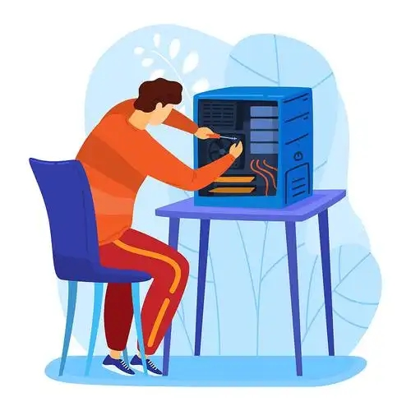
4 Are you going to ask for help this weekend?
ask for 请求，要求；寻找
You can ask for help when you need.
你可以在需要的时候寻求帮助。
ask sb. to do sth.
请某人做某事
I’m going to ask a computer engineer to check it.
我要请一位计算机工程师检查一下。

Slide 15
5 There’s something wrong with my laptop.
There’s something wrong with sth.
……坏了/有问题
There’s something wrong with my bike.
我自行车有点问题
6 My sister Annie’s bicycle is broken, so she’s going to have someone repair it.
have sb. do sth.
让某人做某事
broken adj. 坏的
My hair is long, I’ll have someone cut it.
我的头发很长，我会请人剪的。

Slide 16
7 Some college students are willing to help.
be willing to do sth.
愿意做某事
I’m willing to teach you English.
我愿意教你英语。
8 Do the old people get any help as well?
as well 也、还

Slide 17
C Simon’s community centre needs more volunteers to help. Complete the centre’s notice with the correct forms of the words and phrases in the box below.
college community engineer neighbour
repair tidy volunteer willing to
We need you!
Do you have any free time? Are you (1)___________ help others? Why not be a(n) (2)___________ at our community centre? There are many ways to help!
Planning parties
The people here are all very nice. A tea party or a day out together will be great for (3)___________ to know more about each other. Join us and we can plan these activities together!
willing to
volunteer
neighbours

Slide 18
college community engineer neighbour
repair tidy volunteer willing to
Helping hands
Are you a computer (4)___________ ? Do you know how to fix a laptop?
Or can you (5)___________ things like a broken bike? Or are you a(n) (6)___________ student? Do you want to help kids with their homework? Or would you like to help the old people (7)___________ their flats? We need volunteers like these. Join us and give back to our community.
Let’s clean up!
We are very lucky to live in such a lovely neighbourhood. Let’s keep it looking nice. Can you join us to clean up the park in our (8)___________ this Saturday morning?
Please email us to be a part of our team. We are happy to have you with us any time.
engineer
repair
college
tidy
community

Slide 19
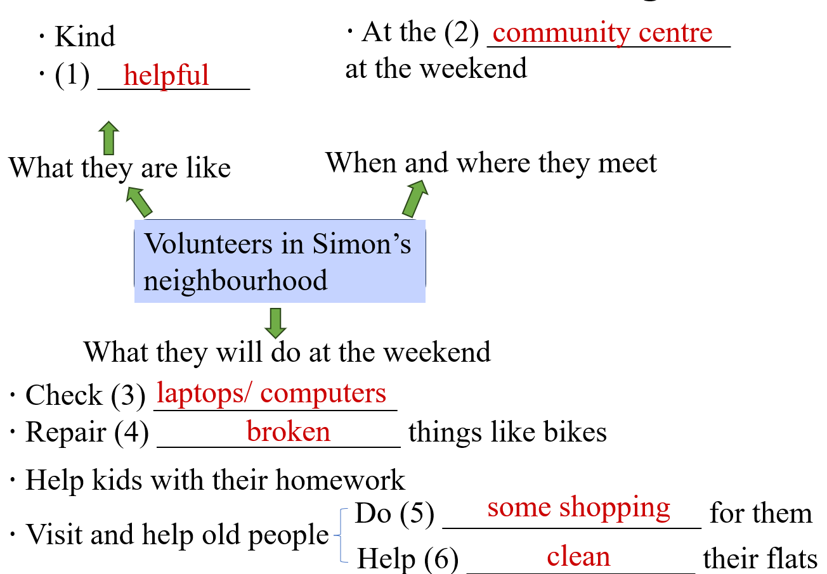
Summary
◆重点词汇
college, community, engineer, neighbour, repair, tidy, volunteer, willing to, ask for, as well, all kinds of
◆课文内容

Slide 20
Exercise
一、用括号内所给单词适当形式填空。
1. Most of _______(our) spend lots of time doing homework.
2. —Can I have a new schoolbag, mum?
—The old one is _________(break).
3. We want to have a ________(meet) in the afternoon.
4. This is my _________(three) time to see the singer.
5. I think it’s going to be a ______(real) nice day tomorrow.
6. Will you do some _________(shop) with me this weekend?
7. Can you find any social _______(work) in your community centre?
us
broken
meeting
third
really
shopping
workers

Slide 21
Homework
1 Write down the things you can do for your community.
2 Read the conversation loudly at home.

