Slide 1
Unit 2
Neighbourhood
Integration (D)

Slide 2
Learning Objectives
In this lesson, we will be able to:
1.Know about the structure of Simon's mind map and learn about what he can do for his community;
2.Write a speech script about what we can do for our communities;
3.Use some useful expressions in our speech script.

Slide 3
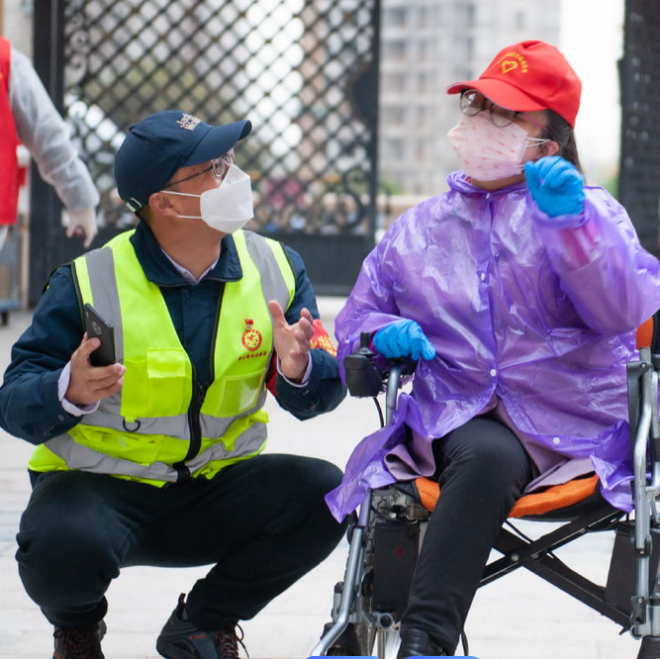
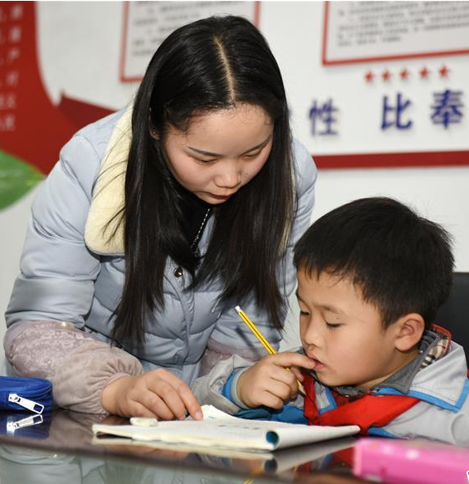
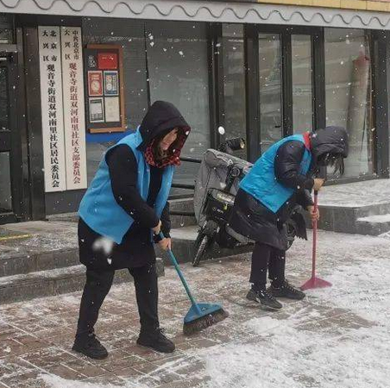
Lead-in
Watch some pictures about community workers and
answer questions below.
Who are they?
What do you want to say to community workers?
What do you want to do for the community?

Slide 4
Pre-writing
Task 1 Talk about something about the community.
D
Mr Wu asked the Class 1, Grade 7 students to give a speech about what they can do for their communities.

Slide 5
Pre-writing Task 2 Let’s talk.
D1
Look at Simon’s mind map of what he can do for his community.
Collect and Share
Old books
Old toys
Old clothes
Share them in the community centre
Give them to kids in need
Sell them to raise money for plants and flowers in the community garden

Slide 6
Pre-writing
Task 3 Let’s read for the structure.
D2
Read Simon’s speech script about what he can do for his community.
Greetings
what
Hello, everyone,
Today, I’d like to share with you my idea for helping our community. I want to organize an activity—“Collect and Share”. Let’s collect old things from the neighbourhood and give them a new life.
Purpose
how
First, we can give away some of our old books. We’re going to share them in our community centre. Second, we’re going to collect old toys. We’ll clean them and then give them to children in need. Last, we're going to ask for some old clothes. We’ll sell them to raise money for plants and flowers in our community garden.
Details
A call to action
I hope you like my idea. Let’s work together to make our community
a better place!
why

Slide 7
Task 4 Outline to organize ideas
Greetings
Beginning
Purpose
Main part
First Second Last
Details
Ending
A call to action

Slide 8
While-writing Let’s write!
D3
Write a speech script about what you can do for your community. Make a mind map like the one in Part D1. Use Simon’s writing as a model.
I’d like to share with you my idea for…
I’m going to organize…
I want/plan/would like to…
I’ll help…
We’ll raise money for…
First/Second/Last, …
I hope you like my idea.
Useful expressions

Slide 9
Post-writing Let’s share!
Ask students to share their speech about what they will do for the community.
The content is clear
The writing is beautiful
The speech is fluency

Slide 11
1. I want to organize an activity—“Collect and Share”.
organize vt. 组织；安排；筹备；规划；整理；使有条理
常见搭配及例句：
organize a party 组织一场派对
e.g. We are going to organize a birthday party for our friend.
（我们打算为朋友组织一场生日派对。）
organize one's thoughts 整理思绪
e.g. Before writing, you should organize your thoughts.
（在写作之前，你应该整理一下思绪。）
organize an event 筹备一个活动
e.g. The school organized a sports event last week.
（学校上周组织了一场体育活动。）

Slide 12
2. First, we can give away some of our old books.
give away 赠送；捐赠；分发；泄露（秘密等）
常见搭配及例句：
give away old clothes 捐赠旧衣服
e.g. I will give away my old clothes to the poor.
（我将把我的旧衣服捐赠给穷人。）
give away the secret 泄露秘密
e.g. Don't give away the secret.
（不要泄露秘密。）
give away free samples 分发免费样品
e.g. The company gave away free samples of their new product.
（公司分发了他们新产品的免费样品。）

Slide 13
3. We'll raise money for ...
raise vt. 举起；抬起；提高；筹募；养育；饲养；引发
常见搭配及例句：
raise one's hand 举手
e.g. Please raise your hand if you know the answer.
（如果你知道答案请举手。）
raise money 筹集资金
e.g. They are raising money for the charity.
（他们正在为慈善机构筹集资金。）
raise a question 提出一个问题
e.g. He raised a very interesting question in class.
（他在课堂上提出了一个非常有趣的问题。）

Slide 15
一、单项选择
1. —What would you like to do for your community? —I ______ to clean the park.
A. would like B. like C. wants
2. We are going to ______ a concert to raise money for the old people.
A. organize B. do C. make
3. The teacher gives some advice ______ the students.
A. for B. to C. with
4. First, we should ______ our classroom. Then we can start the activity.
A. clean B. to clean C. cleaning
5. —Let's raise money for the poor children. —______
A. You're welcome. B. Good idea. C. Thank you.
A
A
B
A
B

Slide 16
二、根据句意及汉语提示完成句子
1. We can ________ (组织) a book fair to show some good books.
2. My mother often ______ (收集) old bottles and sells them.
3. Let's ______ (筹集) money for the poor students.
4. The teacher gives away the homework to the _______ (学生).
5. I would like to ______ (分享) my happiness with you.
organize
collects
raise
students
share

Slide 18
Required(必做)
Edit your writing with your classmates, rewrite it and hand it in.
Optional(选做)
Write a speech about what you will do for your class.

