Slide 1
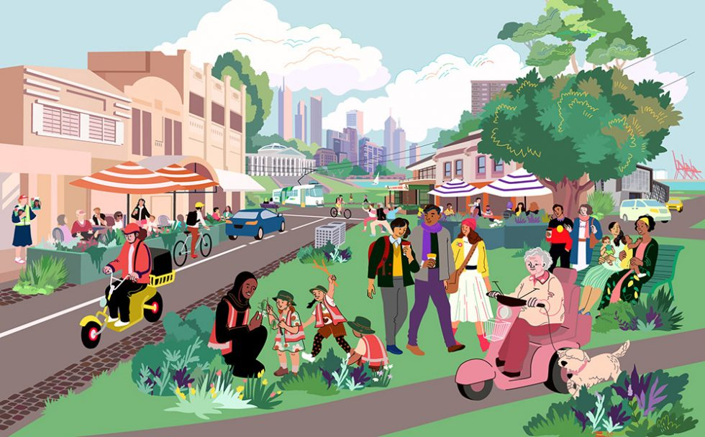
Unit2 Neighbourhood
Welcome to the unit

Slide 2
What makes a good neighbourhood?
close neighbours
a good living surrounding
convenient living facilities

Slide 3
Who maybe gives you timely help when you meet with emergencies(紧急情况), a close neighbour or a distant brother?
Close neighbours are better than distant relatives. (远亲不如近邻。)

Slide 4
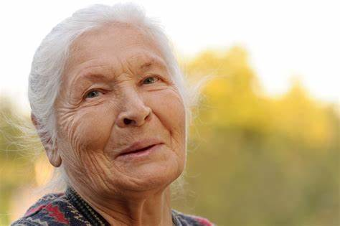
Do you have a close neighbour? Try to talk about his/her job and work place.
E.g. My neighbour, Mrs Lin is a kind and warm-hearted lady, she once worked as a nurse in our community hospital . She often helps me water the plants and look after my pet dog when I am away.

Slide 5
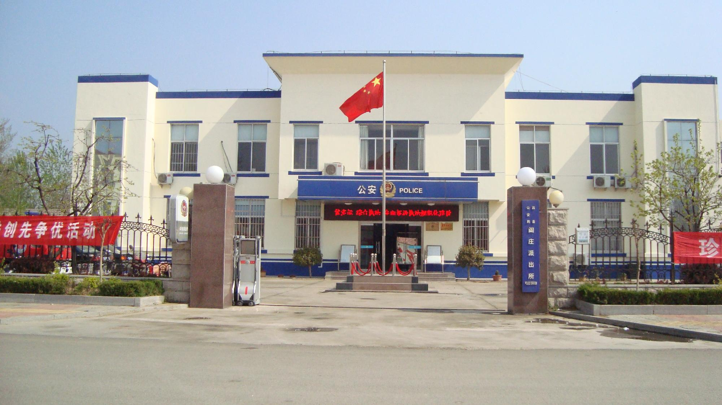
Jobs and work places
police officer
police station

Slide 6
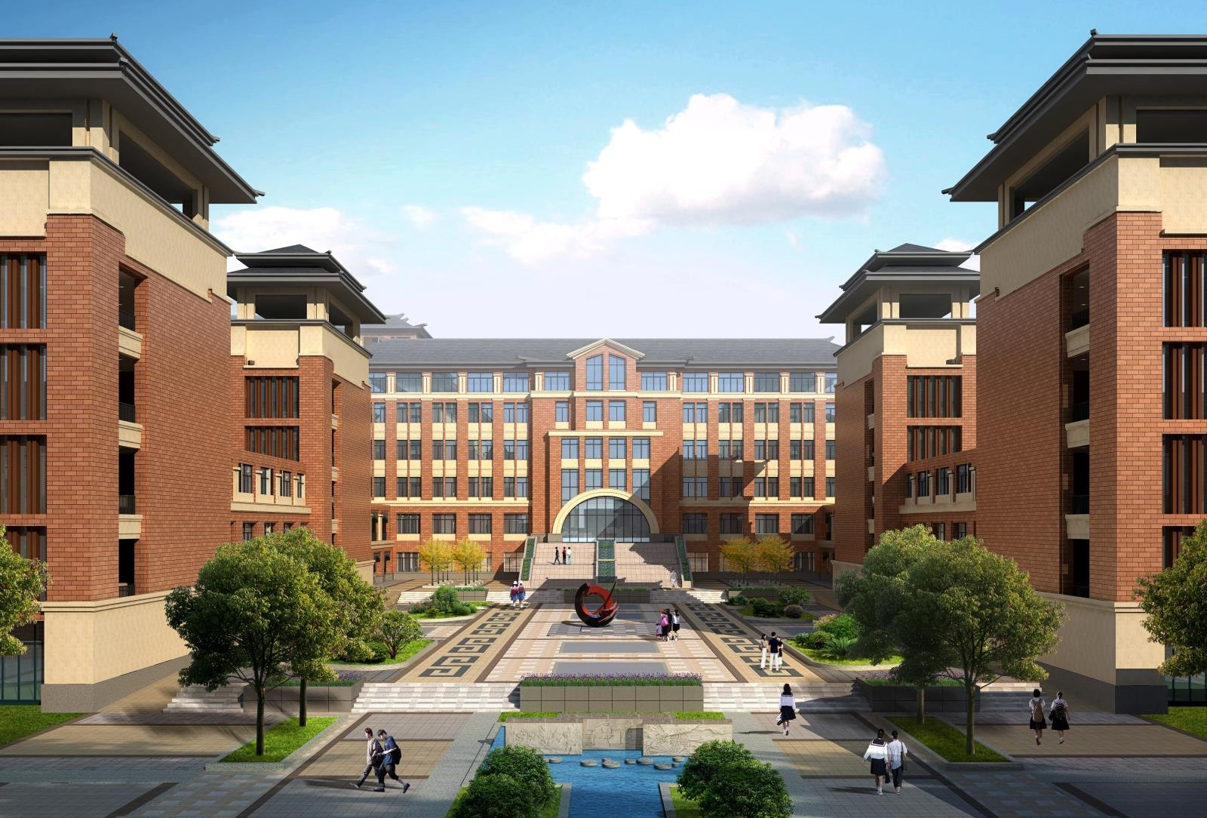
Jobs and work places
teacher
school

Slide 7
Jobs and work places
restaurant
cook

Slide 8
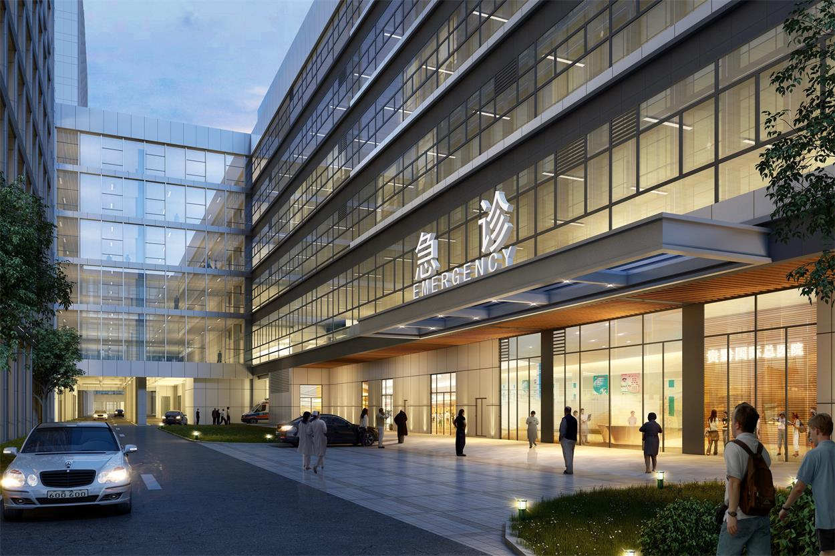
Jobs and work places
doctor
hospital

Slide 9
teacher
school
doctor
hospital
police officer
police station
cook
restaurant

Slide 11
Listen to the conversation, then answer the following questions.
What’s Simon’s neighbourhood like?
What’s in Simon’s neighbourhood?
What does Simon think of his neighbours?
What are Amy’s neighbours like?
How does Mr Zhang help his neighbours?
Nice.
A school, a hospital and a big supermarket.
Lovely.
Kind and helpful.
He helps them learn about laws at the community centre.

Slide 12
Act the dialogue out and make up your new one
A : What’s your neighbourhood like?
B: Nice. There is…. What about you?
A: I also like my neighbourhood. My neighbours are very helpful. They’re always ready to help others.
B: How do they help?
A: Well, Mr Wang …
B: That’s great.

Slide 13
1. What’s your neighbourhood like? 你的社区是什么样子的？
“What‘s ... like?”‌是一个常见的英语句型，用于询问某物、某人、某地或某事物的性质、特点或感受。这个句型的基本结构是“What’s + 名词 + like?”，其中“like” 介词，表示“像……一样”。
用法示例
‌询问人的性格或品质‌：
‌What's your brother like?‌ (你弟弟是什么样子的?)
‌What‘s your boss to work with like ?‌ (和你一起工作的老板怎么样?)
‌询问某物的外观或特征‌：
‌What's the weather like today?‌ (今天的天气怎么样?)
‌What‘s your new apartment like?‌ (你新公寓怎么样?)
[试一试] ( )-________ is your form teacher _______? - Kind and helpful.
A. How; look like B. What; like C. How; like D. What; is like
B

Slide 14
2. They’re always ready to help others. 他们总是乐意帮助别人。
"be ready to do sth." 的用法主要有以下几种：
1.表示“准备好做某事”，通常用于描述一个人已经为即将进行的活动或任务做好了准备。
例如："I am ready to go to school."（我准备好了去学校。）
"She is ready to try again."（她已准备好再试一次。）
2. 还可以用来表达“乐意做某事”的情感。
例如："He is ready to help others."（他乐于助人。）这等同于 "He is happy to help others."（他很高兴帮助他人。）
[试一试] He is a kind-hearted boy and he is always ready ______________(help) those in need.
to help

Slide 15
Test
选用方框内的单词或词组填空，其中有一个单词或词组是多余的lawyer restaurant neighbours doctor community police officers
1.Close ________________ are better than distant relatives.
2.The __________________ work hard to keep the city safe.
3.I am a cook, and I work in a small _______________ in the town.
4. Her mother is a __________ and she takes good care of the patients in the hospital.
5. They often meet at the _____________ center and share their skills.
neighbours
police officers
restaurant
doctor
community

Slide 16
根据句意，用括号中所给单词的正确形式填空
1.We have some _____________ (love) pets at home. They bring us a lot of fun.
2. Are you ready ________________ (join) us for the picnic this Sunday?
3. He is an _____________ (office) in the army. He is very strict with himself.
4. What about ______________ (ride) a bike to school? It's good exercise.
5. Can you help me _______________ (find) my lost key? I can't remember where I put it.
lovely
to join
officer
riding
find

