Slide 1
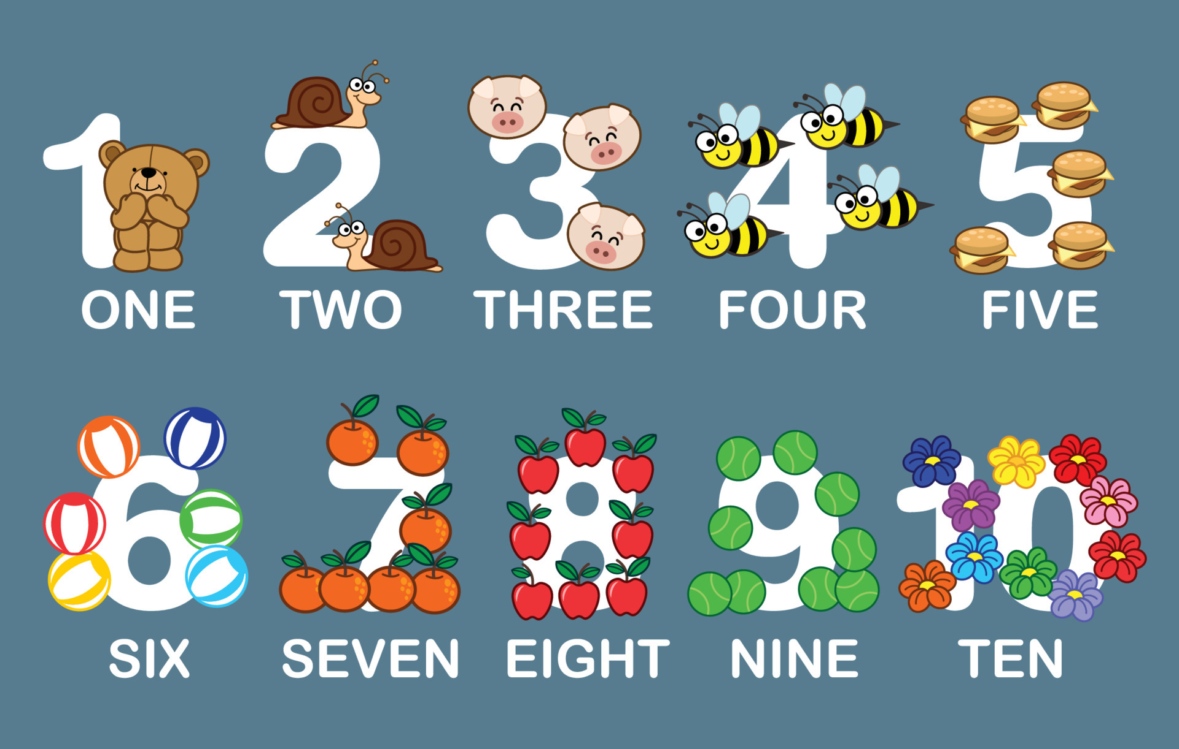
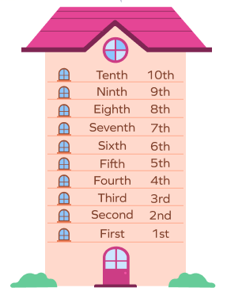
Unit 1 Home
P3 Grammar

Slide 2
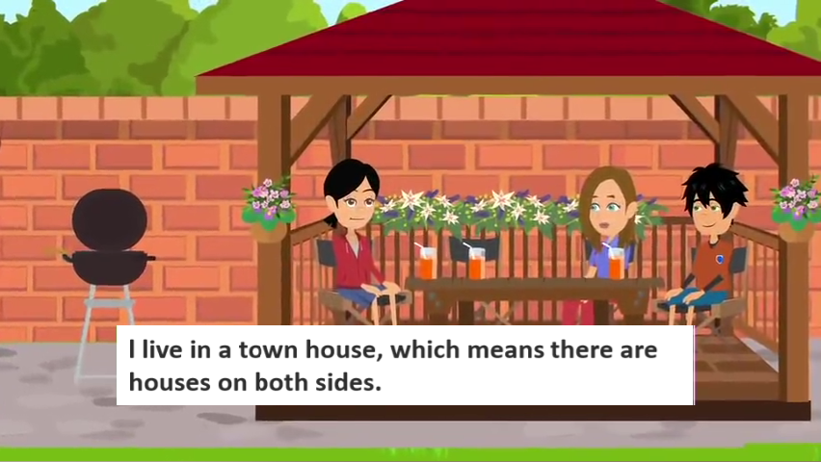
Fill in the blanks.
The girl lives in a town house.
There are _____ floors: the ground floor, the _____ floor, and the _______ floor.
three
first
second
美式英语: apartment
英式英语: flat
Jimmy lives in an apartment on the ______ floor of a high-rise(高层建筑).
There are ______ bedrooms, a big living room, and a kitchen.
Numerals 数词
sixth
Cardinal numbers
基数词
Ordinal numbers
序数词
three
Let's learn more about numerals.

Slide 3
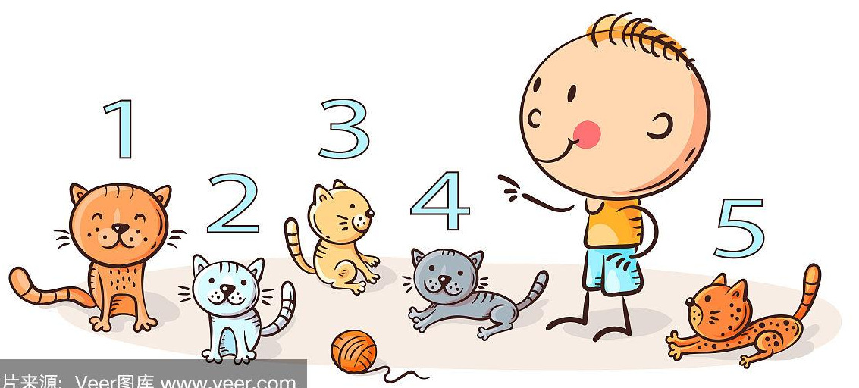
Focus on
用法
Cardinal numbers
1. 基数词的概念
2. 基数词的构成
3. 基数词的用法

Slide 4
基数词
一、基数词的概念
表示数量的多少
We use cardinal numbers almost every day. We use them to talk about the numbers of people or thing.
① Four students are playing volleyball outside.
② There are 20 desks in the classroom.
③ I have two brothers and one sister.

Slide 5
二、基数词的构成
0～12为基本单词:
zero one two three four five six seven eight nine ten eleven twelve
13-19为对应的个位数单词(或变形)后加-teen:
thirteen fourteen fifteen sixteen seventeen eighteen nineteen

Slide 6
20、30、... 90为其对应个位数单词(或变形)后加-ty:
twenty thirty forty fifty sixty
seventy eighty ninety
20以上的非整十数，十位与个位之间用连字符"-"。
21 twenty-one 99 ninety-nine
101～999的三位数，百位数和十位数（若无十位数则和个位数）之间用and连接，百后用单数形式。
100 | one hundred
200 | two hundred
101 | one hundred and one
When we say 'thirteen', we stress the second syllable. When we say 'thirty', we stress the first syllable.

Slide 7
千位数thousand用法同hundred，跟在数词后，表示具体的数字时，通常使用单数形式。
five thousand books 五千本书
2,345 = two thousand three hundred and forty-five
万以上的较大数字：million是100万，用法同hundred，thousand，跟在数词后，表示具体的数字时，通常使用单数形式。
two million 两百万
23,456 = twenty-three thousand four hundred and fifty-six
234,567 = two hundred and thirty-four thousand five
hundred and sixty-seven

Slide 8
Try to read the big numbers below.
4,056 = four thousand and fifty-six
23,813 = twenty-three thousand eight hundred and thirteen
567,110 = five hundred and sixty-seven thousand one hundred and ten
6,425,000 = six million four hundred and twenty-five thousand
We often use a comma or a space to separate big numbers into groups of three from right to left.
在用阿拉伯数字记录较大数目时，通常用逗号或空格将大数目分隔，从个位开始，三个一组。

Slide 9
三、基数词的用法
Read the text below about Neil's home and pay attention to the use of cardinal numbers.
Neil's home is about 15 miles from London. It is on 28 Rose Street. It has an area of 160 square metres. His phone number is 0207 000 1111.
Neil loves taking pictures. He has about 2,000 pictures on his phone. They are very beautiful!
phone numbers

Slide 10
A1
Simon is writing about his home and family. Read the sentences below and pay attention to the numbers in his writing.
1 We live in Room 806, Building 15, City Garden.
2 Our flat is 98 square metres in area.
3 Our phone number is 010-1212 1212.
4 My sister Annie is nine years old, and she is in Grade 4.
5 Mum usually gets up at 6:45 in the morning.
6 My computer costs 4,550 yuan.
A2
Talk with your partner about your home and family, using cardinal numbers.
P11
A1

Slide 11
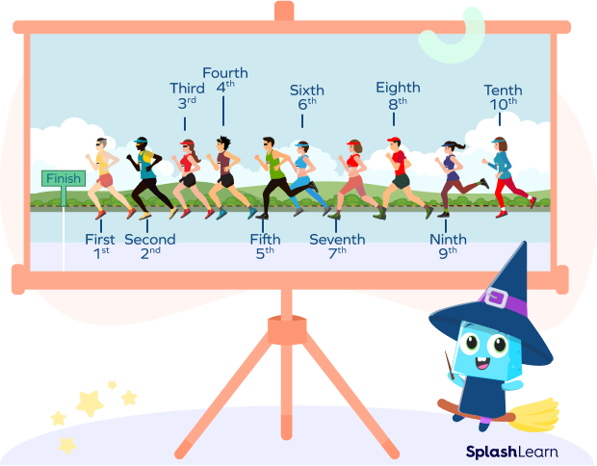
Focus on
用法
Ordinal numbers
1. 序数词的概念
2. 序数词的构成
3. 序数词的用法

Slide 12
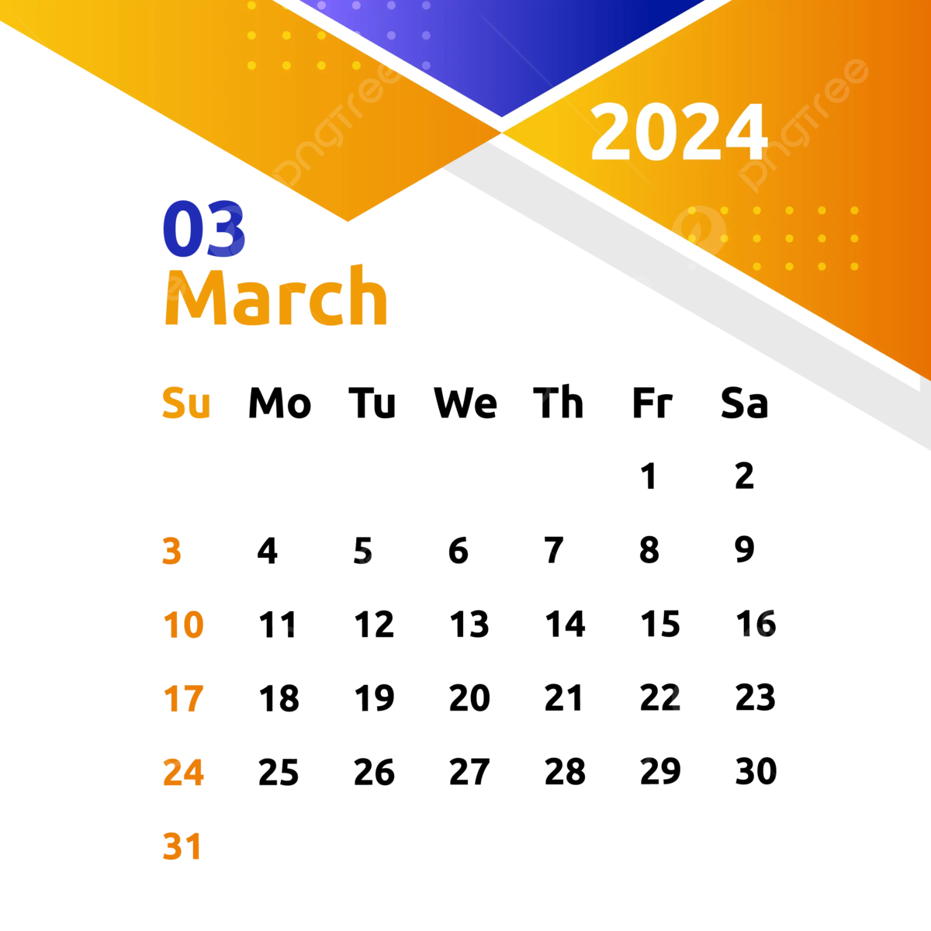
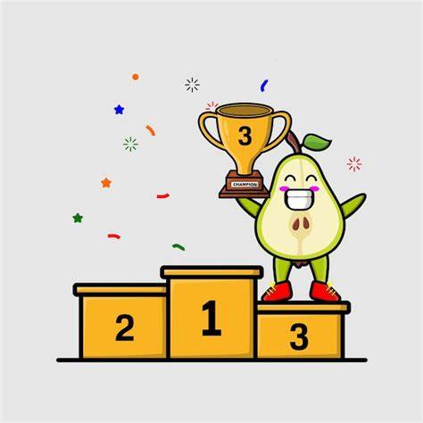
序数词
一、序数词的概念
表示顺序的先后
We use ordinal numbers to show the order of things.
1. Women's Day is on the eighth of March.
2. Our flat is on the seventh floor.
3. She was third in the competition(比赛).

Slide 13
二、序数词的构成
1) 一般来说，是由相应的基数词加词尾th构成。
◇ four + th
◇ seven + th
◇ ten + th
→ fourth
→ seventh
→ tenth
2) 有些基数词在变为序数词时，有特殊的变化。
◇ one ◇ two
◇ three ◇ five
◇ eight ◇ nine
◇ twelve
→ first
→ third
→ eighth
→ twelfth
→ second
→ fifth
→ ninth

Slide 14
3) 20、30、... 90，十位整数序数词的构成方法是将基数词的词尾y变成i，然后再加eth。
◇ twenty
◇ thirty
→ twentieth
→ thirtieth
◇ forty
◇ ninety
→ fortieth
→ ninetieth
4) 20以上两位或两位以上的基数词变成序数词时，仅将个位数变成序数词。
◇ twenty-one ◇ thirty-five ◇ one hundred and one
→ twenty-first
→ thirty-fifth
→ one hundred and first

Slide 15
基数词 & 序数词
基数词 序数词
基数词 序数词
one two three four five
six seven eight nine ten
first
second
third
fourth
fifth
sixth
seventh
eighth
ninth
tenth
1st 2nd 3rd 4th 5th 6th 7th 8th 9th 10th
eleven twelve thirteen fourteen fifteen sixteen seventeen eighteen nineteen twenty
eleventh
twelfth
thirteenth
fourteenth
fifteenth
sixteenth
seventeenth
eighteenth
nineteenth
twentieth
11th 12th13th14th15th16th17th18th19th20th

Slide 16
基数词 序数词
twenty-one twenty-two twenty-three thirty forty fifty sixty seventy eighty ninety
one hundred
twenty-first
twenty-second
twenty-third
thirtieth
fortieth
fiftieth
sixtieth
seventieth
eightieth
ninetieth
one hundredth
21st 22nd 23rd 30th 40th 50th 60th 70th 80th 90th 100th

Slide 17
三、序数词的用法
Read the sentences below about Li Mengtian and pay attention to the use of ordinal numbers.
Li Mengtian lives on the twenty-second floor.
Her birthday is on the twentieth of February.
She is in the seventh grade.
She is always the first in her class to get to school.
floors

Slide 18
序数词前常用定冠词the或物主代词，有时也可用不定冠词或零冠词。
Today is the second of March.
This is my first visit to Shanxi.
Their horse came third in the race last year.
今天是三月二日。
这是我第一次到山西。
他们的马在去年的比赛中获得了第三名。

Slide 19
基数词变序数词顺口溜
1. 基变序，有规律，词尾加上th
2. 一二三 特殊记(first，second，third)
3. 八加h(eighth), 九减e(ninth)
4. ve要用f替，(five→fifth；twelve→twelfth)
5. 变y为ie，(twenty →twentieth，
thirty → thirtieth)-th最后加上去
6. 若是第几十几，前为基，后为序
(twenty-one→twenty-first;
twenty-four→twenty-fourth)

Slide 20
19
22
17
12
29
30
21
26
19
(Cardinal Numbers + Ordinal Numbers)
13
31
15
14
10

Slide 21
B1
Simon is doing a test on ordinal numbers. Look at the numbers below and write the numbers out in words.
first
sixth
twenty-second
seventh
fourteenth
thirtieth
eighth
nineteenth
ninetieth
tenth
one
hundredth
P12
B1

Slide 22
Simon wants to tell his friends about the three bloggers. Complete his sentences with the correct ordinal numbers.
B2
1 Li Mengtian lives in a building with 22 floors. Her home is on the top floor, the _________________ floor. Her family always eat yuanxiao on the Lantern Festival — the __________ day of the first month in the Chinese lunar calendar.
2 Neil is a Grade 7 student. He is in the ___________ grade. He is usually the __________ to get up in his family because he likes jogging in the morning. His mum is the second one, right after Neil.
3 Femi's birthday is in March, the _________ month of the year. Today is his _____________ birthday. He is 13 years old now.
twenty-second
fifteenth
seventh
first
third
thirteenth
P12
B2

Slide 23
用括号中所给提示填空。
1. My uncle lives in a town _______ (15) kilometers from Yangzhou. [2023 扬州市]
2. This piece of music is so beautiful that I'd like to listen to it a _______ (two) time. [2023 兰州市]
3. Jiang Shumei, born in 1937, spent (度过) most of her time working in a factory. In 1996, she learned her ________ (one) Chinese character (汉字). Sixteen years later, she started to write down some of her own stories. [2024 南充市]
fifteen
second
first

Slide 24
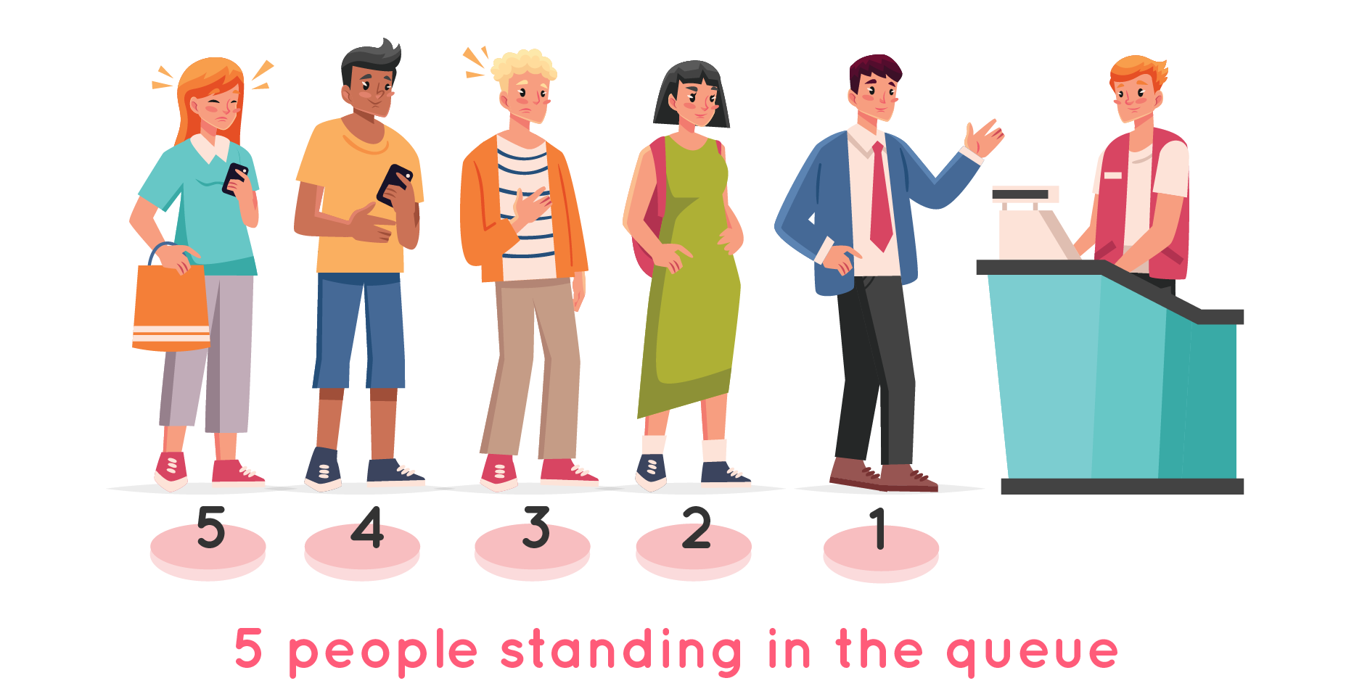
基数词表示数目的多少。
序数词表示顺序的先后。

Slide 25
注: 另附word文档，点击此处链接

Slide 26
Ⅰ. 写出下列词的序数词形式。
1. two ____________
2. nine ____________
3. twelve ____________
4. forty-eight ____________
5. fifty ____________
second
ninth
twelfth
forty-eighth
fiftieth

Slide 27
II. 根据句意或提示完成句子。
1. The firefighters saved eight people in the big fire, three men and ______ women.
2. The _______ letter of the alphabet (字母表) is I.
3. Mother's Day is on the _______ (two) Sunday of May every year.
4. — Sir, your room is on the _____ (five) floor of the hotel.
— I see. Thank you.
five
ninth
second
fifth

Slide 28
III. 根据所给汉语提示，完成下列句子。每空一词。
1. 娜娜试穿了三双鞋，她喜欢第三双。
Nana tried on three pairs of shoes, and she liked
_____ ______ pair.
2. 玛丽的生日是6月6日，她认为6是她的幸运数字。
Mary's birthday is on ______ _________ of June. She thinks ______ is her lucky number.
3. 卡拉是她的第一个还是第二个孩子？
Is Carla her _______ or ________ child?
4. 这是我的公寓，我住在23层。
This is my flat. I live on ______ ______________ floor.
the third
the sixth/6th
six/6
first
second
the twenty-third

Slide 29
1. Can you use cardinal numbers and ordinal numbers properly?
2. Can you talk with your partner about your home and family, using cardinal numbers?
3. Can you write a short text about your family life, using both cardinal numbers and ordinal numbers?

Slide 30
1. Write a short text about your family life, using both cardinal numbers and ordinal numbers.
2. Remember all the new words on pages 11-12.
3. Preview Pronunciation on page 13.

